Slide 1
VLN Criminal Expungement Full Representation Training
Fall 2025

Slide 2
VLN Criminal Expungement Program Staff
Katherine Johnson
Criminal Expungement Case Coordinator
Katherine.Johnson@vlnmn.org
612-752-6605
Elizabeth Fowlds
Criminal Expungement Resource Attorney &
Program manager
Elizabeth@vlnmn.org
612-752-6654

Slide 3
Why is Criminal Expungement Needed?
Societal exclusion due to criminal history
  Employment: Any record, even arrest, can impact hiring decision
  Housing: Scarcity of affordable housing means landlords can be picky about who to rent to
  Other areas of life:
    Coaching, volunteering at kids’ school, community service, visiting incarcerated family members or family members on military bases, etc.
Systemic racism in the criminal justice system
Keeps people in poverty
Expungement is the means to help people overcome these barriers despite past mistakes

Slide 4
What are “criminal records”?
Criminal records are created by numerous different actors at varying points in time.
In Minnesota, a person’s complete criminal record is a combination of all of the files and records for any felony, gross misdemeanor, misdemeanor, or petty misdemeanor ever charged against that person. This includes arrest records.
Every city, county, and state law enforcement agency, prosecutor's office, and court keeps its own records.
State agencies, like the Minnesota Department of Human Services (DHS) and the Minnesota Department of Health, may also keep records of arrests and convictions.
Private background check companies who have acquired information regarding a person’s criminal records and mug shot may sell that information online.

Slide 5
What does Criminal Expungement Mean in Minnesota? What does it do?
Can seal all/most records – Statutory Expungements under 609A.02; also some prosecution led expungement programs
(will not come up in background checks, licensing, etc.)
Can seal some records – automatic expungements 609A.015; Expungement by the Cannabis Expungement Board under the Adult Cannabis Use Act
...Or it can seal only judicial records – inherent authority or partial expungements
(basically, only the public can't see it)
Sealing does not mean destroying, erasing, or vacating convictions.
There are situations where an expunged case can be seen/used

Slide 6
Here are those situations . . .
Expunged/sealed records can be viewed and shared among “criminal justice agencies” when investigating or prosecuting a crime.
Records can be used by law enforcement agencies against applicants for employment in the agencies

Slide 7
Main Types of MN Criminal Expungements
1. Arrest-only expungement
  Only requires a letter sent to the BCA, if the criteria are met under Minnesota Statute 299C.11. If not met, this request can be made by expungement petition Expunge Arrest Records - Criminal Expungement
2. Statutory Expungement – Minn. Stat. 609A.02
  Can seal court record and all records of agencies served,
  case will no longer come up on background checks
3. Inherent authority: usually not very helpful
  Judge uses power over court system to seal only court records
  Record is still on background checks, but client will have court order
  Crimes not enumerated in statute
4. Prosecutor-Agreed/Led Expungements (Help Seal My Record Programs) – 609A.025
Prosecution Stipulates to the expungement
5. Automatic Expungements
Under the Adult Cannabis Use Act, 609A.055
Under the Clean Slate Act, 609A.015
6. Expungements by the Cannabis Expungement Board – 609A.06

Slide 8
Expungement by Petition – The Focus of VLN’s Criminal Expungement Program
Expungement by petition can provide clients with the most effective relief
  All agencies involved in the case can be served with copies of the expungement petition and proposed order (this gives them notice and an opportunity to be heard)
  If granted, the court usually orders records sealed at all agencies served
  Expungement by petition is a means of requesting expungement of records that are excluded from expungement under Minnesota’s Automatic Expungement and Adult Cannabis Use Act Expungements

Slide 9
Criminal Expungement Timeframe
Preparation
Gathering information and completing a petition
Service and Filing
Serving agencies whose records may be affected
Hearing
Short court hearing
Filing with courts
Expungement Order
Expungement
It can take up to a year
63 days
(minimum)
Up to 90 Days
60 Day Appeal Period

Slide 10
Minnesota Judicial Branch Website
- A Useful Resource
Minnesota Court Records Online
https://publicaccess.courts.state.mn.us/
Public access to court records. This is where you may be able find details about a case needed for the expungement petition (EXP102) and proof of service (EXP104).
If a case has been automatically expunged, you won’t be able to look it up here. Details may also be found in the records provided by the client that you’ll get from VLN
Expungement Page
https://mncourts.gov/help-topics/criminal-expungement
This page has links to FAQs, to statutes, and to expungement forms.
The page has fillable smart forms that you can save for editing. When you have the forms completed, click the prepare for eFile button to flatten the document for efiling

Slide 11
Additional Judicial Branch Website Links
Find Your District - Find Courts
A directory to the different judicial districts
File A Case
Information on filing your case in court and on efiling

Slide 12
Expungement Forms
Current forms can be accessed on the Minnesota Judicial Webpage: Criminal Expungement - Forms
Each case needs its own set of pleadings
Most cases will need 4 forms
The Notice of Hearing and Petition for Expungement (Form EXP102)
A (Proposed) Order (Form EXP105, EXP106, or EXP107)
A Proof of Service (Form EXP104)
A Fee Waiver Affidavit. When you represent a client who is eligible for full representation, an Affidavit of Attorney for Court Fee Waiver may be used. (Form FEE116) Form: FEE116 Affidavit of Attorney for Court Fee Waiver There is no filing fee for cases that were findings in favor of the defendant (outright dismissals and acquittals)
Katherine Johnson will send out periodic emails requesting case updates. Please respond to these requests even if there’s not much to report yet. And do let us know if you have questions or need any support

Slide 13
Getting Started
Sign up as a volunteer with VLN!
https://www.vlnmn.org/volunteer-registration/
Time commitment:
  10-15 hours estimated for 1 case, spread over 6-8 months
    About 5 additional hours per case you take on
    Often clients have more than one case, sometimes in more than one jurisdiction

Slide 14
Full Representation
Taking a case
Let us know when you’re ready to take on a case and we can give you some options
  Keep an eye out for our case paneling emails where we highlight clients needing a volunteer attorney
  Let us know if you’re interested in working with one of the clients sent for your consideration
  Let us know what you need to run a conflicts check
Please let us know the results of the conflicts check and whether you’ll be taking the client on. If you take on the client, we will email you:
  Client contact information
  A VLN Representation Agreement for you and your client to fill out
  The client’s criminal records
  Which case records they are seeking to have expunged and a brief description of why it is needed
Meet your client (phone, zoom, in person)
  Complete a representation agreement with the client and send it to Katherine.Johnson@vlnmn.org
  Interview your client and begin the process of drafting the expungement petition
  Gather information on why client is seeking expungement, and what rehabilitative steps they have taken

Slide 15
The Expungement Petition
Questions 1-5: These answers can come from your client
Your client’s BCA record may have another name or alias for your client listed for your client. If so, include this information on question 2.
Sometimes clients have difficulty with listing all of their addresses since the date of the offense for which they are seeking expungement. They should take some time with this and try to do their best.

Slide 16
The Expungement Petition -
Where you tell your client’s story (Questions 6 and 13)
Hardship: First part of the burden!
Question 6 – Reasons for this Request
Why do they need an expungement: must be more than concern for reputation or because it would make the client feel better
  Denials of employment, housing, educational opportunities, volunteer opportunities, being disqualified from being a familiar caregiver, etc.
  Write in the first person, from the client’s perspective
  Be as specific as possible and attach documentation of denials when possible

Slide 17
Telling your client’s story continued
Rehabilitation: Second part of the burden!
Question 13 – Personal Rehabilitation
In the case of conviction, what has your client done since the time of the offense toward personal rehabilitation? Treatment, work, education, volunteer work, community involvement, and other personal history show rehabilitation
  This can include work done while on probation but should also include things done since the discharge of probation
  Be specific and creative
    "Addressed mental health" vs. "began therapy in x year and successfully graduated from a six-month program“
    Spend some time getting to know your client and to develop trust and you’ll likely find things to include that they might not be something they share right away
  Please be mindful that clients’ situations and perspectives on their involvement in the criminal justice system can vary greatly. We want the court to see our client as an individual and to see their growth and potential

Slide 18
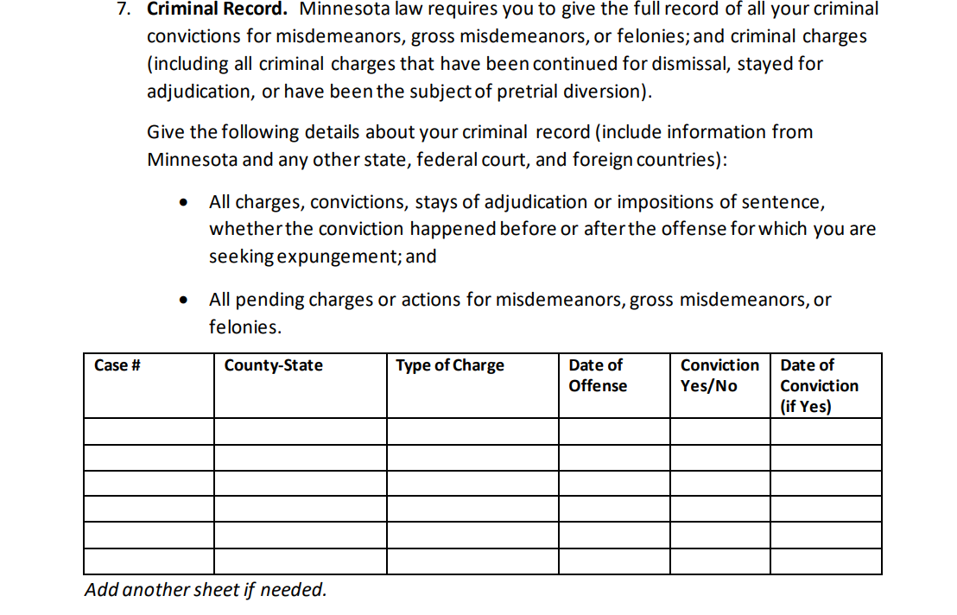
Petition Question 7
Include all criminal charges, even dismissed cases
  Better to include and explain than to leave off
  Petty misdemeanors are not considered crimes under Minnesota law
    Convictions: MCRO or BCA
    Dismissals: BCA

Slide 19
Question 8
Past Requests:
The petitioner must disclose prior AND concurrent expungement requests
In addition to requests by petition, application for prosecution led expungements can be included
Pardon requests should be listed as well

Slide 20
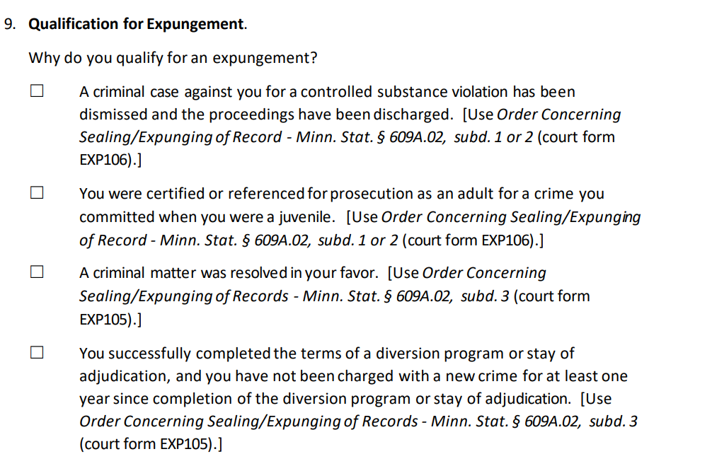
Question 9
The legal basis for the expungement request.
The legal basis also directs you to the correct Order to use (EXP105, EXP106, or EXP107)
(The list to the right is only a partial list of the grounds for an expungement request)

Slide 21
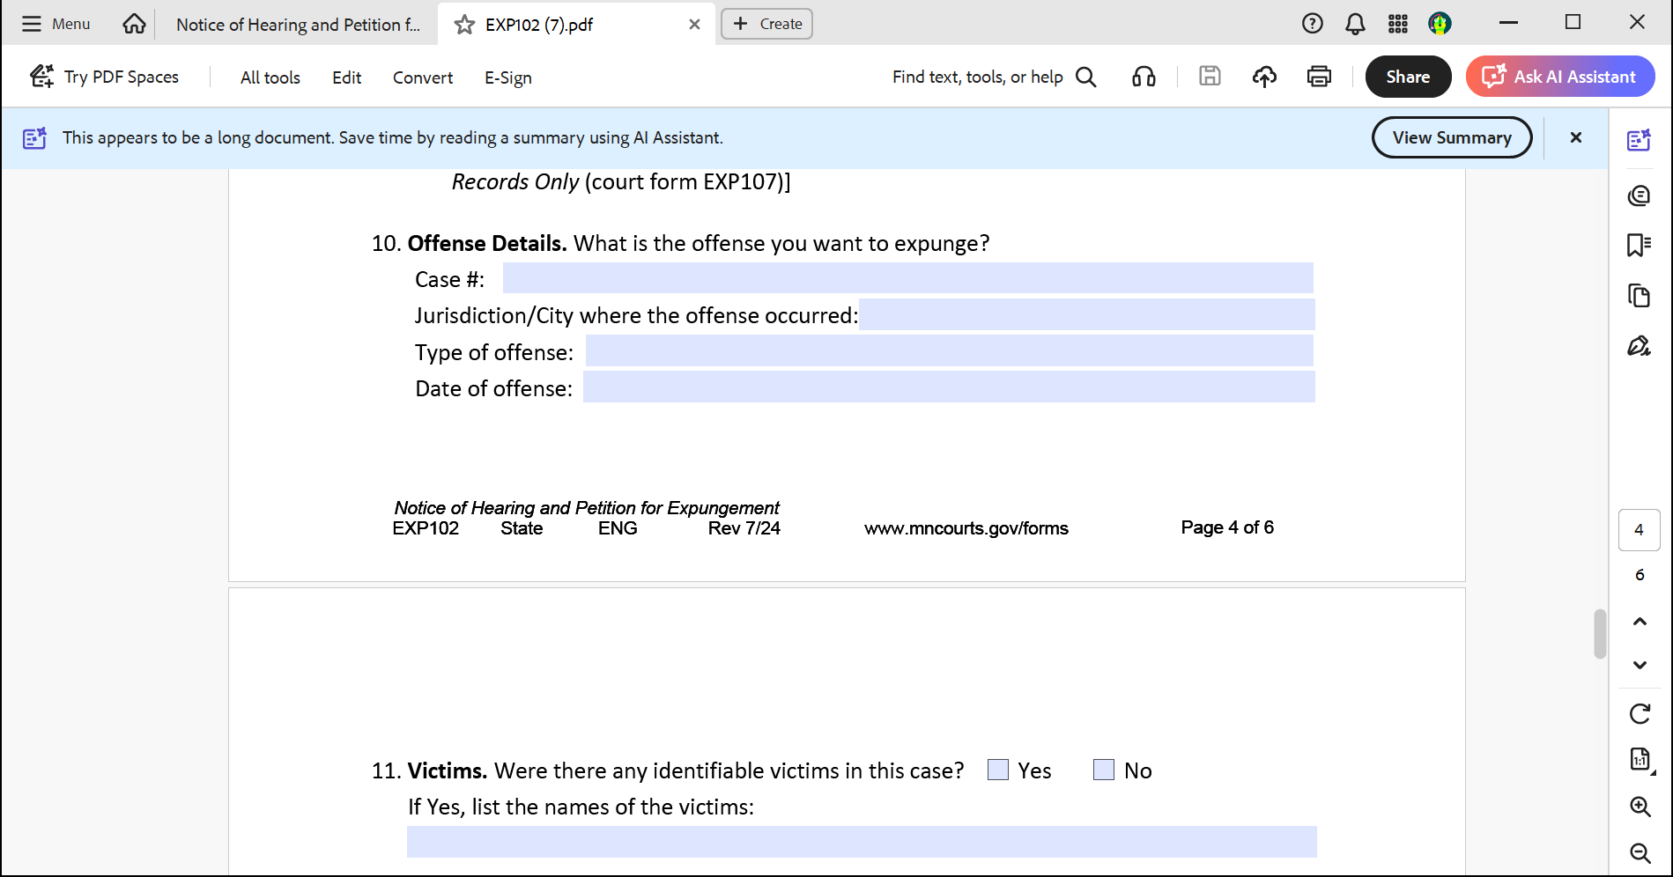
Question 10

Slide 22
Question 10 continued
The answers to question may be supplied in your materials describing the client’s case
They may also be found on Minnesota Court Records Online (MCRO)
They may also be found in the client’s BCA record
The Register of Actions for the case

Slide 23
Questions 11 & 12
Question 11
Victims can be:
  People
  Groups
  Places
  Businesses
Victim name:
  Ask your client
  Obtain a copy of the criminal complaint
  Check MCRO or the Courthouse
  VLN will supply this information if we have it
Question 12
Check “is” if there is or was an order preventing the petitioner from contacting the victim (otherwise “is not”)
  If “is” is checked, the petitioner must get a copy of the order from court and attach it
Orders for protection:
Listed in MCRO history "FA DV" cases
Part of conditions for the case being expunged
  Stay away order – print out a copy of the sentencing order or register of actions for the case
  Domestic Abuse No Contact Order (DANCO) – Courthouse or try MCRO
  VLN will supply this information if we have it

Slide 24
Question 13
If the client was found guilty either by trial or guilty plea:
  It’s important for them to take responsibility for their actions if they can and to discuss what they’ve learned and/or how they’ve addressed factors that may have led them to come before the court.
  If a client had a finding in their favor:
  The client should not accept responsibility. There is really no need to show rehabilitation, however it is a good opportunity to discuss that the client is a law-abiding, contributing member of society.
(In addition to what was stated above in the discussion with question 6)

Slide 25
Rehabilitation ideas
Substance use treatment
AA Meetings, NA meetings
Mental health program
Therapy
Medication
Involvement in faith organizations
Volunteering
Successful relationships /Successful parenting
Employment
Worked things out with victim in case
Removing themselves from people and places that were not conducive to a productive, law abiding life

Slide 26
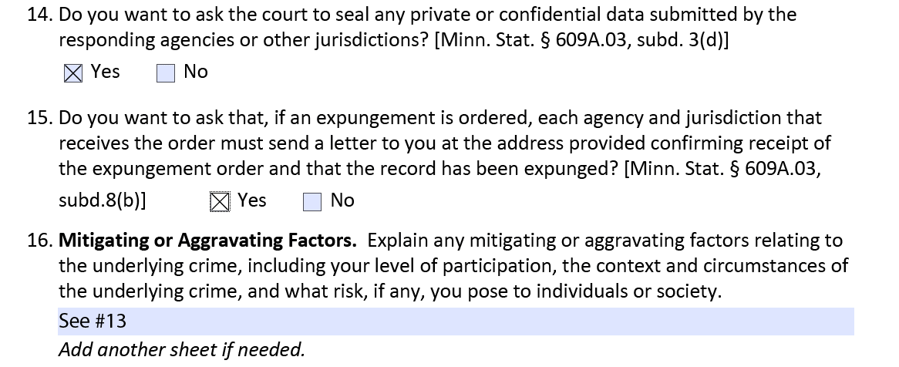
Questions 14, 15, and 16

Slide 27
Question 16
Mitigating Factors
  Factors that provide context and circumstances that demonstrate mitigation may be helpful, particularly if the client has addressed the circumstances.
  It is important, however, that the client understands that an expungement hearing is not an opportunity to relitigate the case. It is generally not helpful for a client to deny responsibility for a conviction, particularly if they have admitted guilt by pleading guilty.
  If there was a conviction and there weren’t mitigating factors, it’s acceptable to refer the court to the response to question 13. The rehabilitation information in question 13 can also go toward assuring the court that the client is not a risk to individuals or society
Caveat

Slide 28
Order (Proposed)– EXP105, EXP106, or EXP107
The majority of records will use will be EXP105
  The grounds for the expungement petition selected in question 9 directs you to the correct order for the case
Filling out the form:
  Fill out the case caption
  If desired, you can fill out the remaining parts of the proposed order however the fillable forms do not have fields for this
  Not all jurisdictions use this order
  You may want to use the form with the case caption for service and filing and have a proposed order with what you want to court to find prepared to submit to the court at or after the hearing. Some judges may request that you supply them with the order and findings

Slide 29
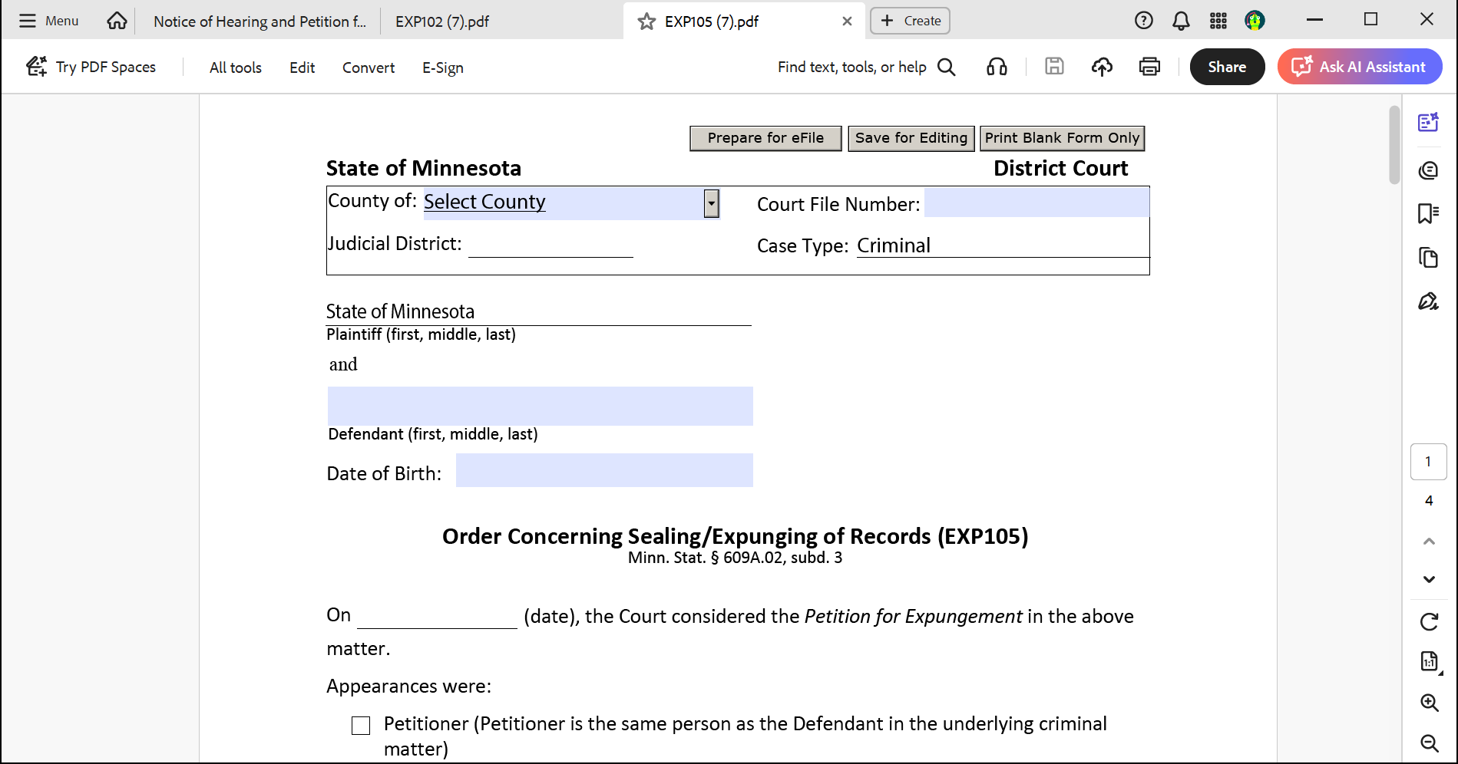
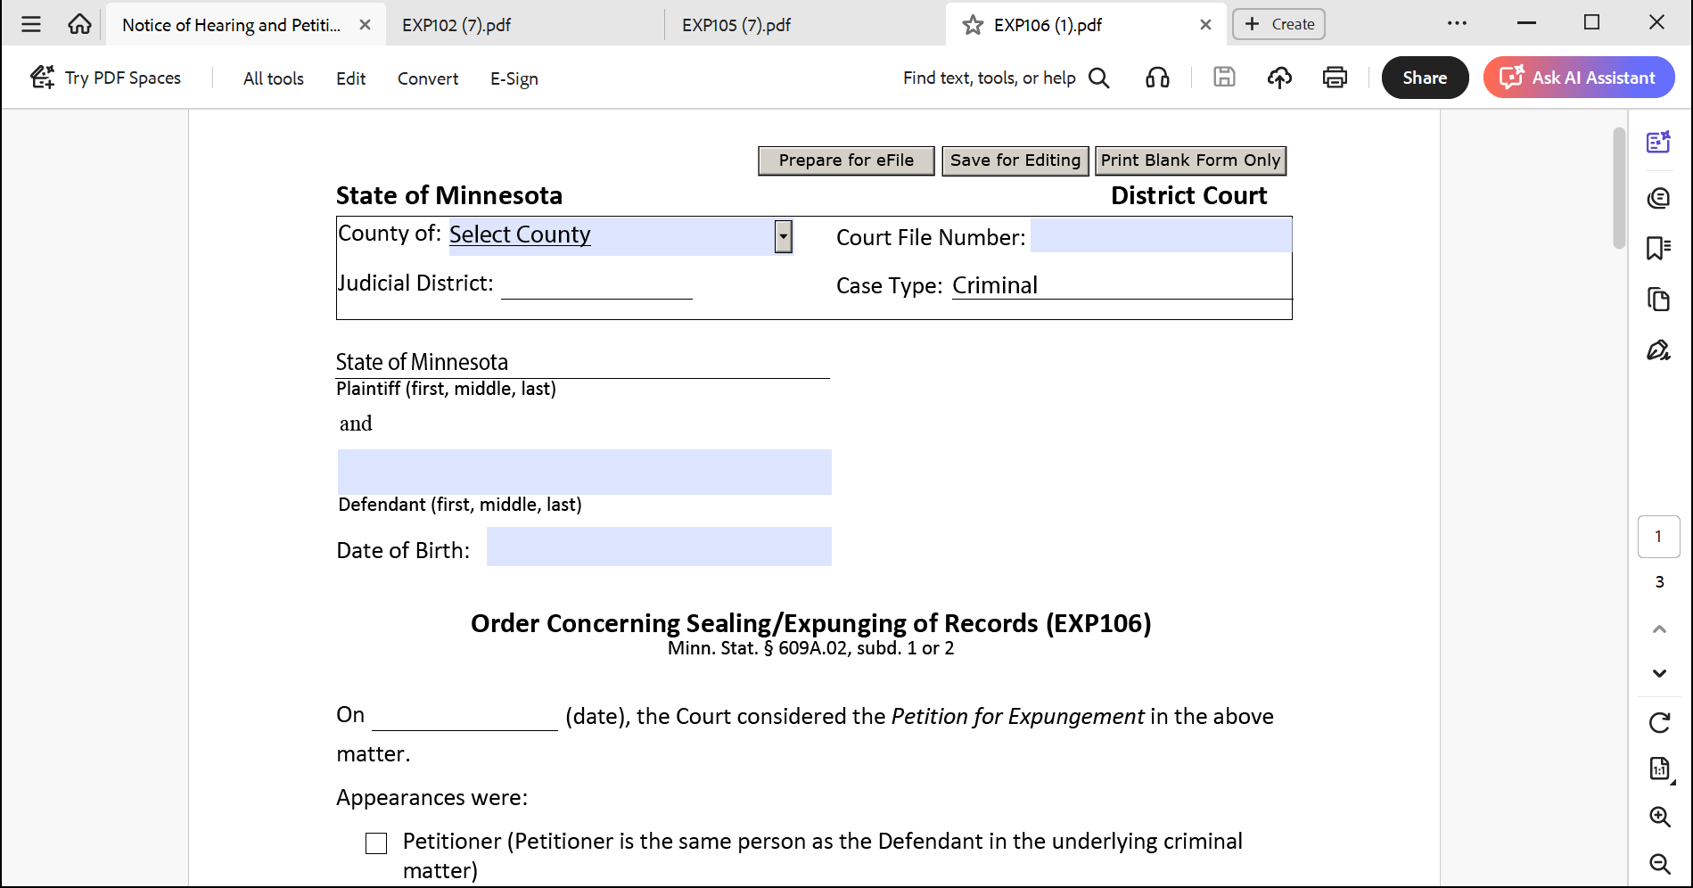
Orders – EXP105 & EXP106

Slide 30
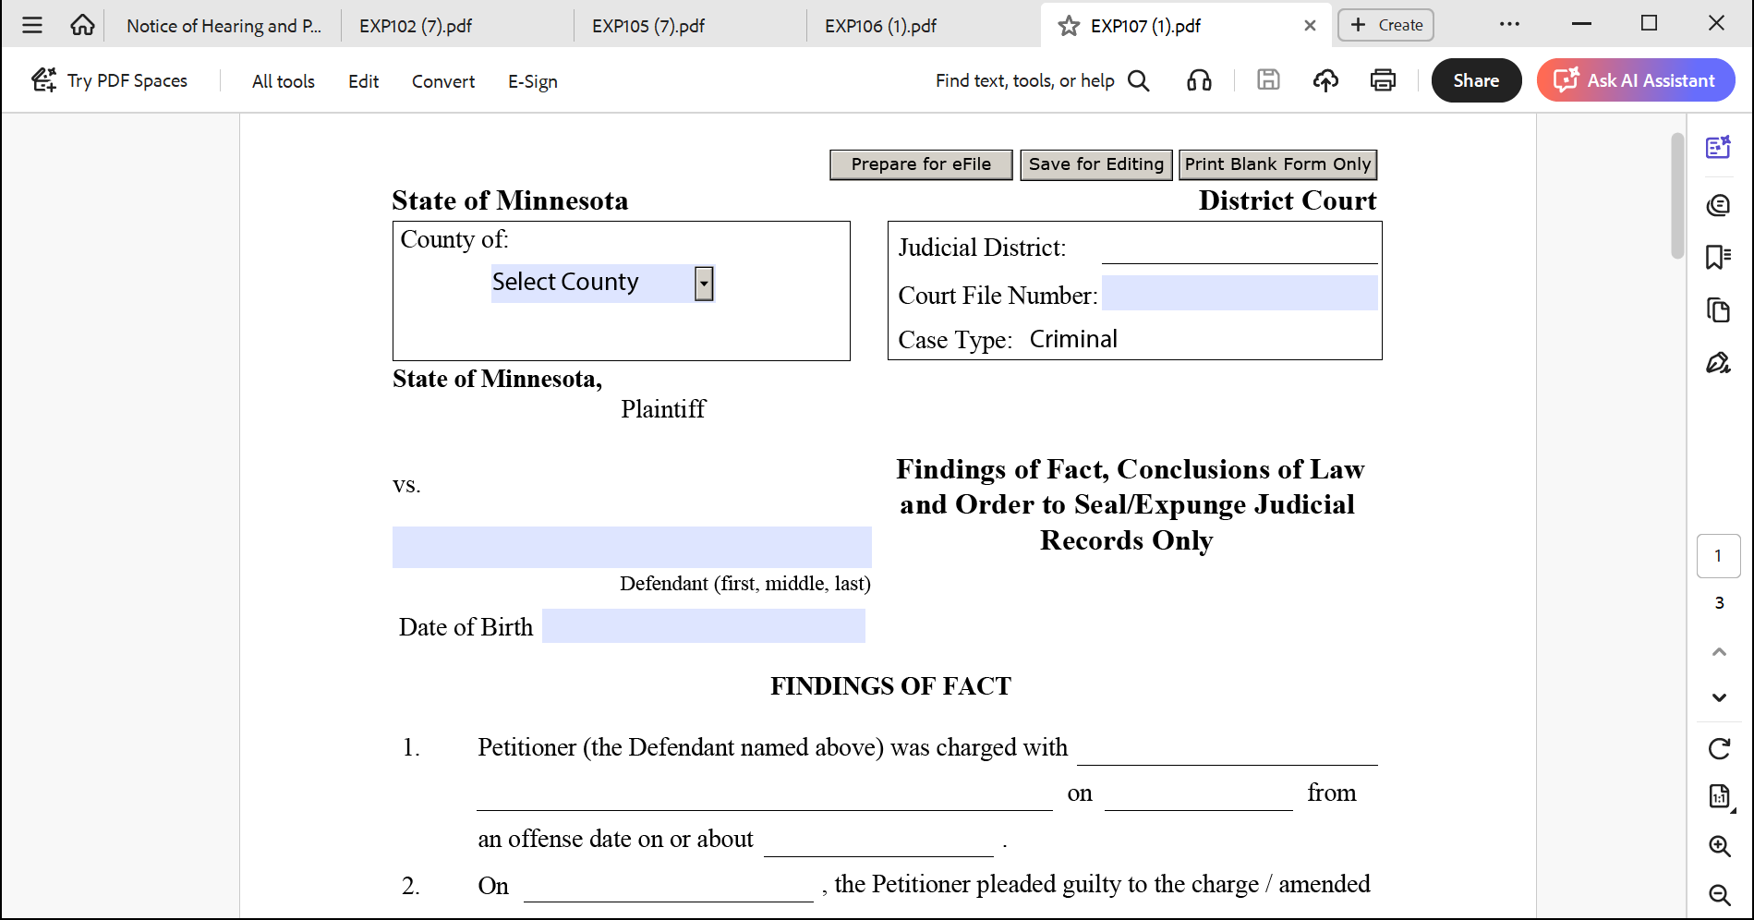
Orders continued – EXP107
Used for Inherent Authority Expungement Requests, which are not a focus of our program, but you may choose to do one of these in concurrently when working on cases with a client that qualify for full statutory expungement

Slide 31
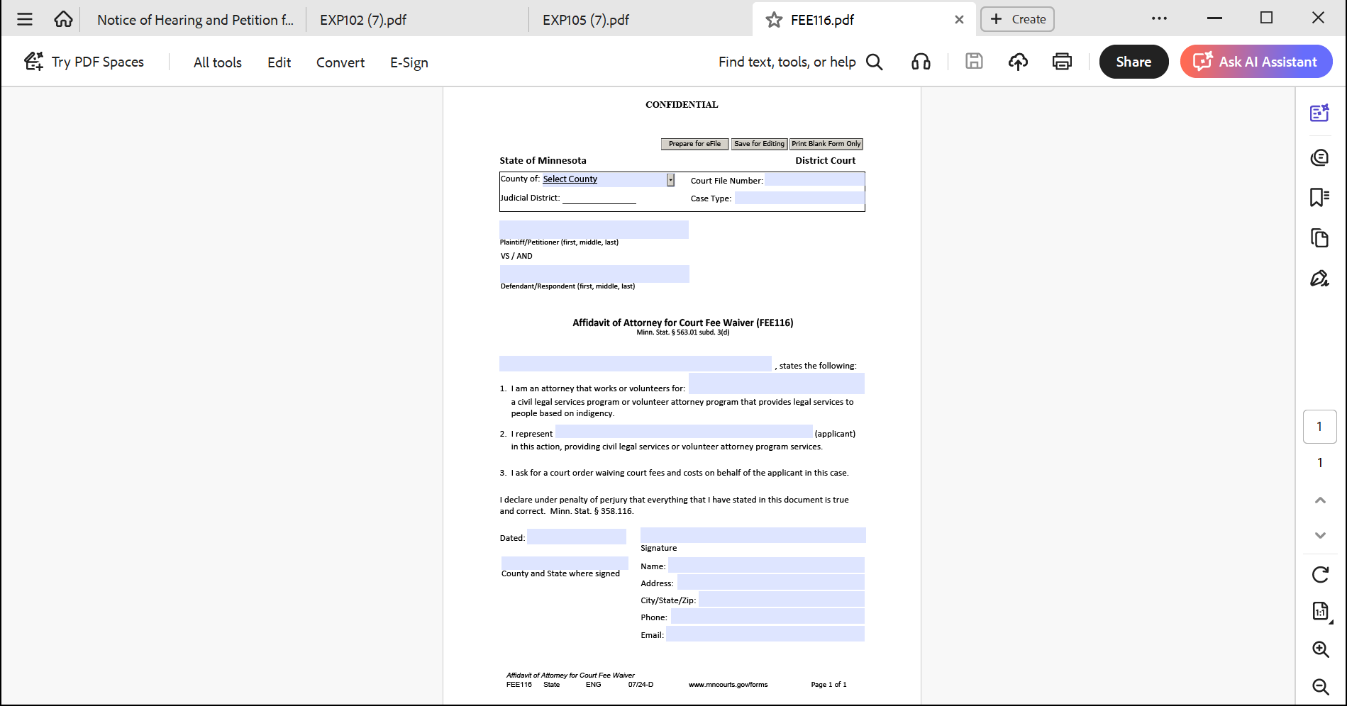
Affidavit of Attorney for Court Fee Waiver – Form FEE116

Slide 32
Proof of Service – Form EXP104
The proof of service is where you indicate which agencies are to be served with the expungement petition and proposed order for the record
  All agencies that have pre-checked boxes (boxes 1-6) on the form must be served
  In addition, law enforcement agencies and municipal prosecutors need to be served if they were involved in the case (boxes 7 and 8)
    This information can be found in MCRO, on the Register of Actions for the case, and on the client’s BCA record
  Boxes 9 and 10 should be served if a client is seeking clearance to work in a field requiring DHS or Department of Health background check clearance
    If a client has a record that has been automatically expunged but that is insufficient relief, these will usually be the agencies needing to be served.
    It’s a good idea to serve these two agencies even if a client doesn’t have a specific need at the moment for this type of clearance. Family caregiving or other issues often arise for people
  Boxes 11 – 13 should be served if the case involves records held by these agencies
  Boxes 14 and 15 are available to add agencies for service
    Commissioners of children, youth, and families, professional educator licensing and standards board, or other agencies impacting your client

Slide 33
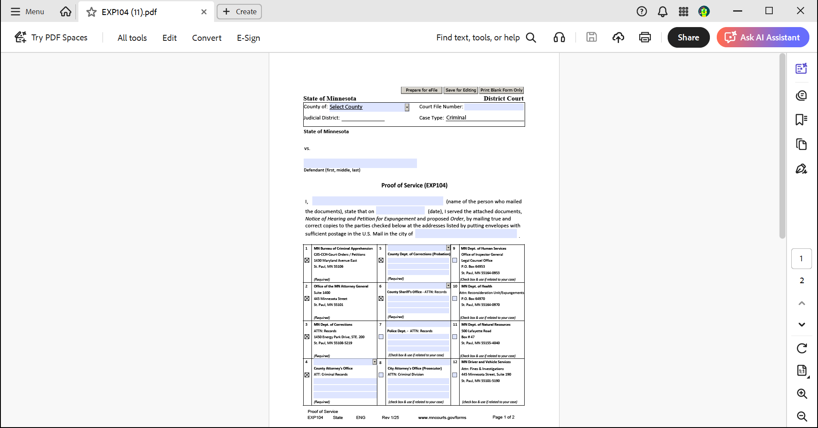
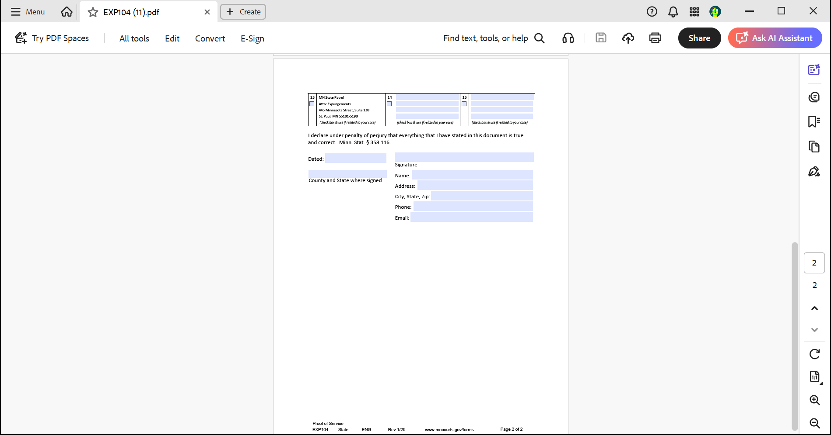
Proof of Service (EXP104)

Slide 34
Review and Finalize Pleadings
Review for accuracy
Edit
Make sure you have attachments you want to submit with the petition
Elizabeth Fowlds, elizabeth@vlnmn.org will be happy to review your documents if you’d like (this is not required)

Slide 35
Have the client review and sign the petition
Digital signatures are acceptable: /s/Client’s Name
Make sure all of your client’s information under the signature line is current

Slide 36
Schedule the expungement hearing
  Call the county court administration to schedule – you can find the directory on the Judicial Branch Website
    Some courts want the filings before they will give you the hearing
    Some courts do not have hearings but will review the pleading papers submitted and make a ruling
  Confirm if the court hearing will be remote or in-person
    the default in Minnesota is remote but some courts still conduct these in-person
    If it’s likely to be in-person, VLN will give you notice of this when sending the client to you for potential placement
  Schedule a hearing date at least 63 days out from service
    Build in more time for service and filing, so 70-75 is best
    Enter the date, time, and location in the Notice of Hearing section of the Petition
  Add the Hearing information to the Notice of Hearing and Petition for Expungement

Slide 37
Service
Service:
  Mail the following to every address on the proof of service form you need:
    Petition and supporting documents
    Proposed Order
    Can also send your certificate of representation
    The Fee Waiver Affidavit it NOT part of service
  About 10-12 copies, separate envelopes, mail at same time
  Whoever serves the documents completes and signs the Proof of Service
    Do not serve this document!
Poof of Service Form EXP104

Slide 38
Filing
Full representation requires that you e-File your documents into the case
Register
Add fee waiver account
Always click "file into existing case"
Upload documents: Petition and attachments, Order, Proof of Service, and Fee Waiver (if needed)
Use "fee waiver" for payment

Slide 39
The Expungement Hearing
Short hearing
Objections: You may get an objection from an agency you served
  e-Filed prior to hearing
  You can e-File a response and/or respond at the hearing
  An objection does not mean the request will be denied
Hearing Prep with Client
  Discuss basic courtroom etiquette / zoom with client
  Prepare the client for questions based on the petition and objections
  You can ask the court clerk for information on how to observe a hearing
Prepare a brief argument focusing on the 12 factors in the statute. Minn. Stat. Sec. 609.A03, subd. 5(c)
  You’ll go first as the moving party
  Judge may ask you or client questions
  Address any arguments related to objection letters

Slide 40
Ruling
The court may rule from the bench
More likely that the court will take the matter under advisement and issue a written ruling
Can take up to 90 days for a ruling
If the expungement order is granted, it is not final until 60 days have passed. This is to allow for any appeal of the decision
If the expungement is denied, sometimes there is an indication of why in the order denying the request. This can be that the court had determined that more law-abiding time is needed, that the need for the expungement wasn’t deemed sufficient, etc. VLN does not handle appeals, but sometimes the court makes a mistake about the interpretation of the law that might be corrected by a letter to the court asking for reconsideration and why
A denial does not mean that a client cannot request for expungement again. Generally, we recommend waiting two years unless there was a change in the law regarding eligibility

Slide 41
Case closing
Please keep a copy of the expungement order or denial for your records and send a copy to VLN
If you haven’t already sent a copy of VLNs signed representation agreement, please send this to VLN
Katherine.Johnson@vlnmn.org
Please fill out a VLN Case Closing form: https://vln.formstack.com/forms/closing

Slide 42
Questions?
If they come up anytime during your volunteer work, please feel free to reach out to Katherine or Elizabeth at VLN
We are here to help and if we don’t know the answer to your questions, we’ll do our best to find the answer for you

Slide 43
Thank you!

