Slide 1
Name and Gender Marker Changes in Minnesota
Volunteer Lawyers Network LGBTQ+ Community Legal Clinic

Slide 2
Presentation Overview
Overview of Process and Appointments
Working with Trans Clients with Brandon St. Germaine
Forms / Steps: Name Change Applications & Gender Marker Corrections with CB Baga
Common Complications with Daniel Wassim
  Name Change Confidentiality
  Name Changes with Criminal History
  Name Changes for Minors
  Out of State Documents
Immigration with Rocío McKenzie Iglesias

Slide 3
Introduction to ID Document Corrections Process

Slide 4





  Check goals
  Revise and fill out forms
  File with Court
  Hearing
  Fix records
Hearing

Slide 5
  Look for:
  Minor
  Fee Waiver
  Gender marker plans
  Birth Certificate state
  Criminal history
  Confidentiality
  LawHelpMN Generator
  MNCourts.gov Fee Wavier generator
  Check:
  Language for birth record
  Childrens’ birth record corrections
  Criminal history disclosures
  Gender marker in court or no?
  How?
  E-file PDFs
  Mail
  Courthouse
  What?
  Fee waiver affidavit and proposed order
  Application for name change and other relief
  Criminal history check release
  Proposed order
  Witnesses
  Support papers
  Usually on zoom
  Judge must be able to find the statute standards are met
  Second order for gender marker
  Attorney recc. for:
  - Confidentiality
  - Felony Conviction
  - Order directed at another state
  - Minor with unsupportive parent
  Social security
  Drivers License/state ID
  Passport
  Birth Record
  Everywhere!
  Watch out for:
  Places you’ll need correct ID soon—consider timing/options
  Do you want everything to match?
Assess Goals
Revise & Fill out Forms
File
Hearing
Update Documents

Slide 6
Anatomy of a Clinic Appointment

Slide 7
Brief Services Appointment Overview
Introductions:
Who you are, why we do pro bono (flag inclusion by sharing your pronouns and/or self-disclosing if you see fit)
Nature of brief services clinic – we are client’s attorney for the duration of the meeting not before/after, all the usual attorney rules apply e.g. confidentiality/privilege, etc. Client can schedule a follow-up appointment if needed.
Have reviewed appointment request information –
  Anything else they’d like us to know / have in mind / address right away?
  Identify client’s goals and concerns.
  Validate stressors/fears – ensure client feels heard.
Legal advice:
  Scope to the time available
  Provide overview and information to client about their situation and next steps needs
  Assist with filling out forms, answering questions, demystifying process as needed
Close-out:
Ensure clinic data sheet is filled out online or in local file/paper (signature not required). Give to VLN with summary.
Iterate to client the nature of brief services—can make another appointment if needed.
Send forms / links to anything discussed.
Assist with warm handoff for any referrals on full rep issues if possible.

Slide 8
Trauma-Informed Support

Slide 9


Trauma-Informed Support:
Know Your Audience
Recognize Dysregulation
Validate, Reflect, Direct, Delay
Set Boundaries & Expectations
Provide Resources
Basics:
Know your audience:
  Use respectful pronoun etiquette: https://www.thetrevorproject.org/resources/article/understanding-gender-identities-and-pronouns/
  Provide your own gender markers to invite sharing. If you don’t know, ask!
  If you make a mistake, correct yourself and move on.
This process can be stressful & triggering.

Slide 10




Recognize Dysregulation:
Hyperarousal/Acute Stress Response - Fight, Flight, Freeze, & Appease.
Dysregulation is NOT noncompliance.
Recognize these in yourself, too!
Fight:
Irritation
Frustration
Feeling Attacked
Defensiveness
Blaming
Flight:
Anxious
Avoiding
Distracted
Dismissive/Interrupting
Freeze:
Confused
Quiet
Indecisive
Repeating
Appease/Fawn:
Agreeability
Rapid-speech
Apologizing
Self-Criticism

Slide 11


Respond to Dysregulation:
Listen
Validate
Reflect
Direct
Delay
1. Listen:
Emotions
Intention/Goals
2. Validate:
Repeat the emotions
“That would be frustrating,”
Recognition not Agreement
3. Reflect/Clarify:
Summarize using their own words.
“I hear you saying that you’re getting overwhelmed.”
4. (Re)direct
Focus on the immediate
Set Expectations & Boundaries
Offer what you can do now
“Let’s try to get this finished, and circle back to resources for these other things.”
5. Delay
Take a break if possible/necessary.
“Let’s try to get this finished, and circle back to resources after”
“Would you like a few minutes?”

Slide 12

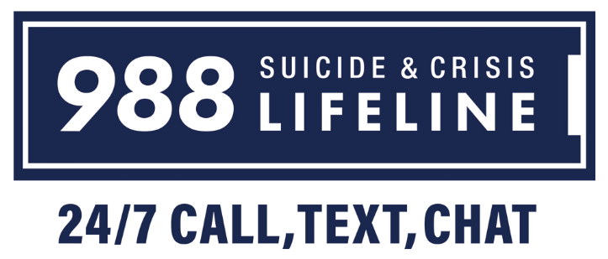
Respond to Dysregulation (Cont):
DONT:
Try to fix/solve immediately.
Provide advice, or personal anecdotes.
Blindly agree/defer.
Minimize, joke or make promises.
Sharing your emotions/fears.
In Case of Crisis:
It’s important and okay to ask if someone feels unsafe or suicidal.
If so, provide 988, Trans Lifeline, and Trevor Project resources.
Only contact non-emergency or 911 in case of confirmed immediate danger.

Slide 13

Set Boundaries & Expectations:
You are not a therapist or case worker
Providing mental health, emotional, or clerical support to someone in crisis without proper training or support is dangerous and harmful. Directing others to the proper resource and allowing them to seek it out themselves leads to the best statistical and emotional outcomes.
Boundary Setting Phrases:
“I am unable to provide emotional, mental health, or direct clerical assistance. You deserve to be heard by someone who is trained and equipped to provide help.”
“I have to end our discussion as this is no longer within the scope of my work.”
“It seems we’re not likely getting this done today, maybe we can circle back to it in an hour/day/week?”
“I am not comfortable and am going to end this discussion, now.”

Slide 14

Trauma/Crisis Resources:
The United Way
  Call: 211 or Text: Zipcode to 898-211* Site: https://211unitedway.org/
  Covers housing, food, mental health, healthcare, ID help, emergency shelters, Caseworkers and more
The Minnesota Warmline
  Call: (651) 288-0400 or Text: 85511 Site: https://mentalhealthmn.org/what-we-do/peer-support/minnesota-warmline/
  Provides non-crisis listening and support for up to 20 minutes a day.
Trans Lifeline
  Call: (877) 565-8860 Site: https://translifeline.org/
  Crisis Support for Trans youth and adults.
Trevor Project
  Call: (866) 488-7386 or Text: 678678 Site: https://www.thetrevorproject.org/get-help/
  Crisis Support for Trans youth and young adults.
The Suicide Prevention Lifeline 988
  Call/Text: 988
  Crisis/Addiction/Suicide Support.

Slide 15

Review:
Know Your Audience
Recognize Dysregulation
Validate, Reflect, Direct, Delay
Set Boundaries & Expectations
Provide Resources

Slide 16
Forms and Process

Slide 17
  Check goals
  Revise and fill out forms
  File with Court
  Hearing
  Fix records

Slide 18
Goals:
Attorney recommended:
Outstate gender marker order
Out-of-state birth record order
Confidentiality
Felony criminal history
Minor with unsupportive parent
Decide:
Which gender markers do you want?
Is it important for everything to match?
What timeline is important to you?
Are there any requirements you aren’t sure about?

Slide 19
  M or F Only
  Self-declare gender marker has been ended, but is not consistently enforced
  Name change Court Order
  Get form online, make appointment, (as early as minutes after your hearing)
  Go in-person with your form SS-5, ID(s), and name
  change order (if app.)
  Options: M/F/X
  Self-declare gender marker
  Name change Court Order
  Social Security first— at least the day before you go to the DMV
  Must do within 30 days of name change, or in MN it is a misdemeanor crime
Social Security
Drivers License / State ID
Birth Record
Passport
Non-MN: Check transequality.org,
state forms & name change clinic
  M & F, now
  X’s are valid IDs
  Can’t get a new / renewal with X
  Name change Court Order
  Application for renew or new passport
  In MN: Application, notarized +
    court order + an ID to fix name
    court order, ACT Letter OR Variance Request to fix gender marker
    M, F, X, or remove gender marker

Slide 20
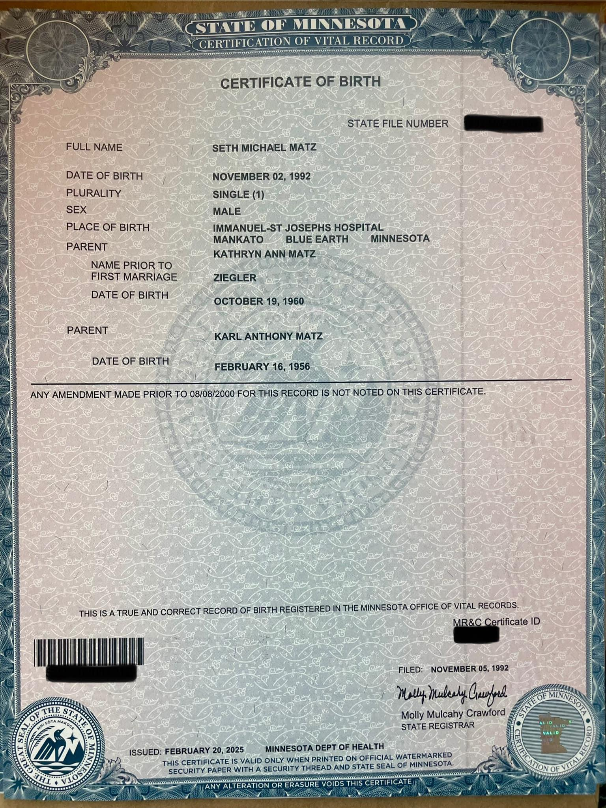
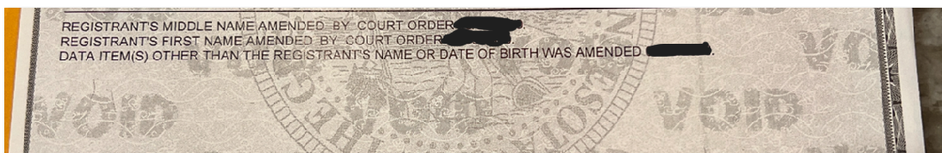
Birth Records:
1) By “amendment”
2) “Issue and register a REPLACEMENT”

Slide 21
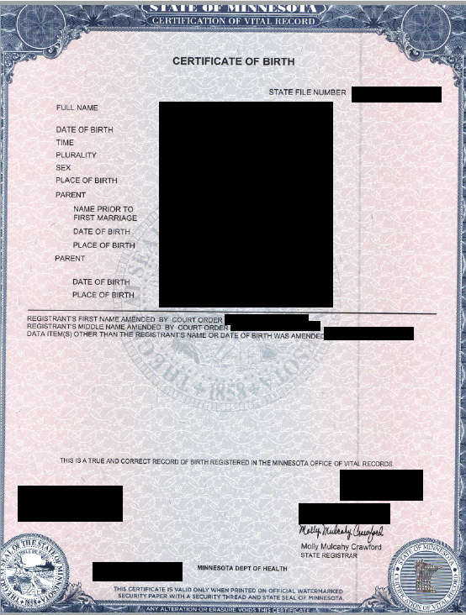
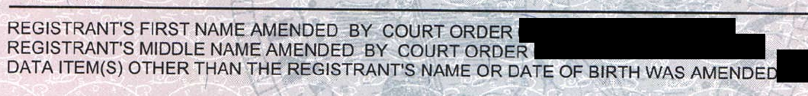
Amended Birth Record

Slide 22
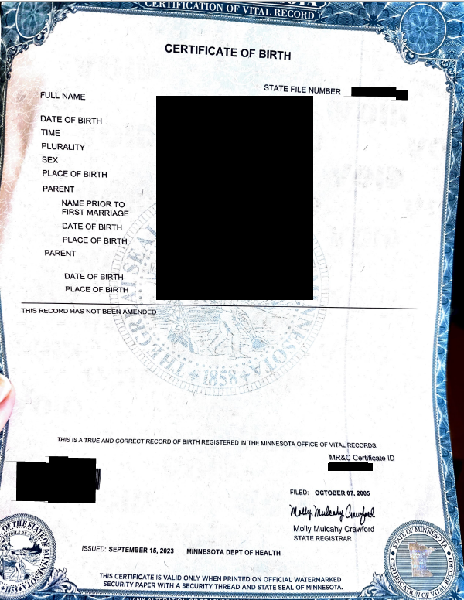

Replacement Birth Records

Slide 23
  Check goals
  Revise and fill out forms
  File with Court
  Hearing
  Fix records

Slide 24
Name Change Application
Procedure and requirements for name changes are established in Minn. Stat. § 259.10 et seq.
Eligibility
Applicant must have lived in Minnesota for 6 months
Applicant must be a resident of the county where they are applying for the name change
Applicant must be applying for a proper purpose; not have intent to defraud or mislead.
If you move to a new county, you have to re-apply in the county you now reside in
Notes:
https://www.mncourts.gov/Help-Topics/GetForms.aspx?cat=Name+Change

Slide 25
Name Change Application - Forms
Forms for Minnesota name change petitions are available online here: https://mncourts.gov/GetForms.aspx?c=27
And can be easily generated: https://www.lawhelpmn.org/self-help-library/legal-resource/name-change-minnesota-court-forms-and-information
There are three key forms:
NAM 102 - Application for Name Change and Other Relief
  Petition document. Sets out the information required by statute for name changes.
NAM 103 - Criminal History Check Release
  Minn. Stat. § 259.11(b) requires the court to determine whether the applicant has a criminal history. This form
  provides information for a background check.
NAM 107 - Proposed Order Granting Name Change
Additionally, some applicants may be eligible for a fee waiver. If fees would be overly burdensome, consider filing an affidavit for proceeding in forma pauperis.
DO NOT FILE without checking on complications / goals e.g. felony, birth record, and confidentiality if these apply!

Slide 26
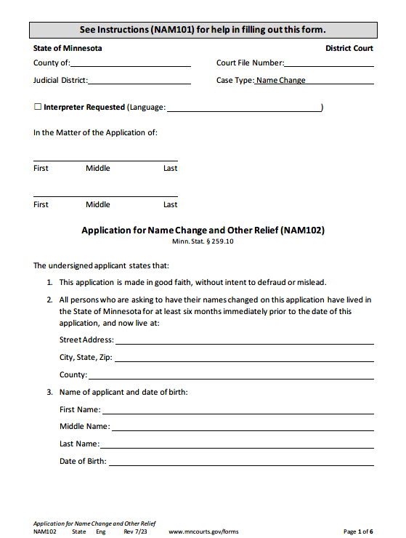
Name on current legal identity documents
Address where mail can be received
Name and DOB on current identity documents
Add line if correcting birth record to ensure the name and DOB on current birth record are in order, or for other unique history-of-name-change details
NAM 102 - Application for Name Change and Other Relief

Slide 27
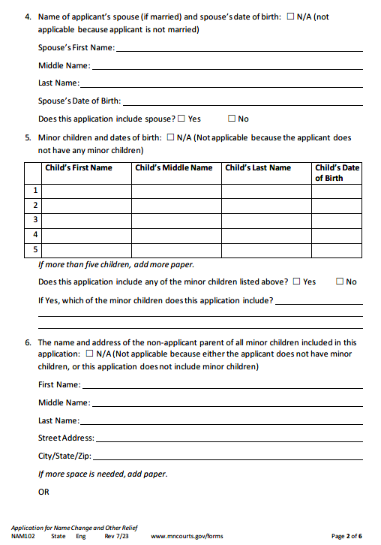
x
x
x
Spouse/Child details:

Slide 28
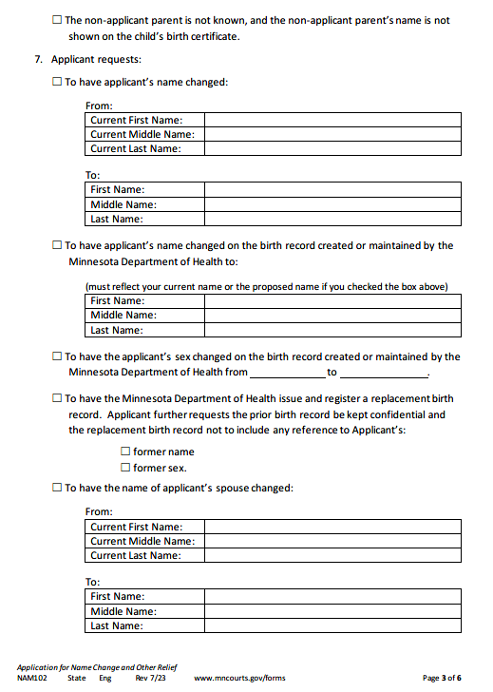
x
Current First Name
“ “ middle
“ “ last
New First Name
New Middle Name
New Last Name
x
New First Name
New Middle Name
New Last Name
x
[SAAB] [Corrected marker]
x
x
x
Relief:

Slide 29
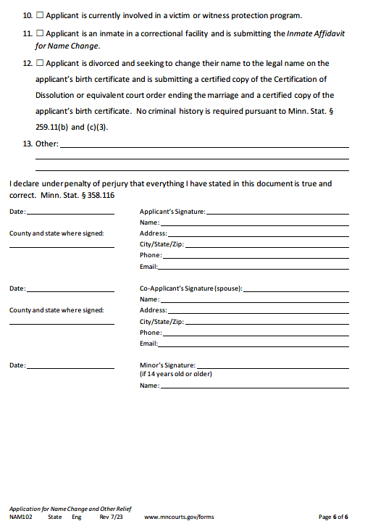
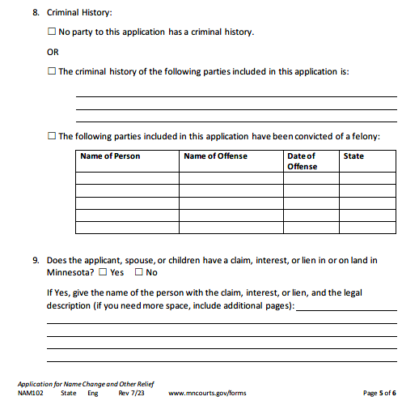
x
Follow court Instructions for how to list; err on side of disclosure or help client look up.Original intent was self-attest, courts are now requiring background check more
Consider children’s birth records, marriage license,
and other personal factors
No notary required
x
Spouse/Child details:

Slide 30
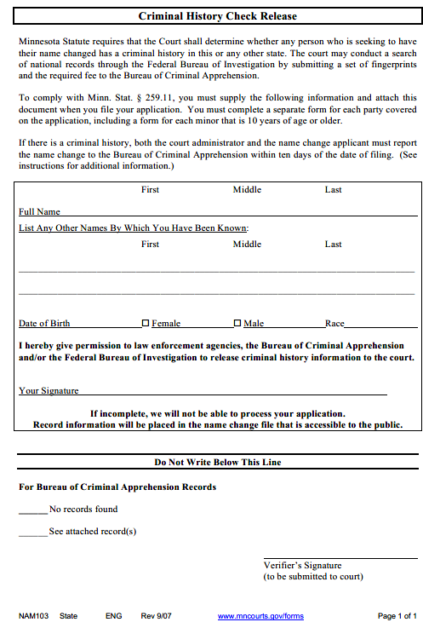
On current legal identity documents
For background check / police purposes
<- whatever the government would probably have on file, or whatever you want
On minor version, Applicant parent signs; background check required for 10yo+
NAM103 – Criminal History Check Release

Slide 31
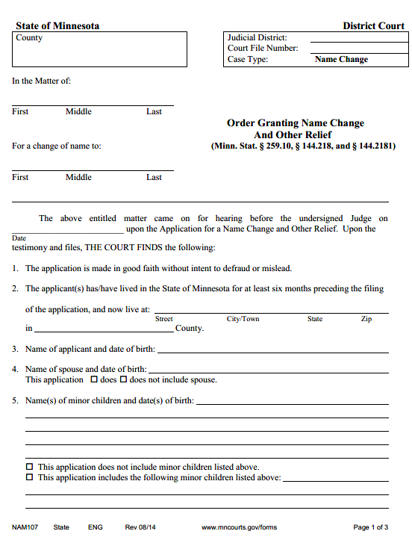
Both names in caption:
NAM107 - Proposed Order

Slide 32
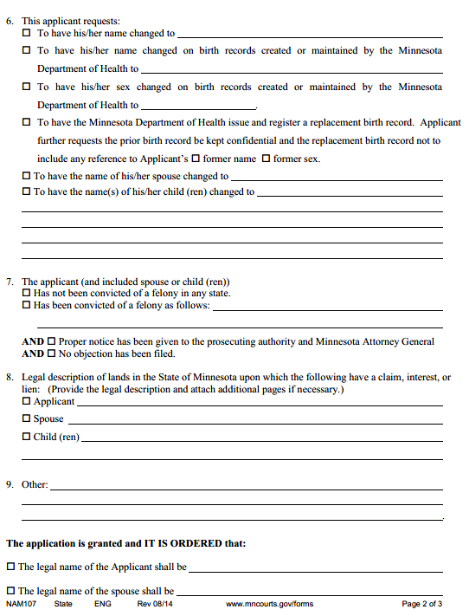
Same content without the “from” -
NAM107 - Proposed Order
<- the Court filing or self-help desk might tell them not to fill out below this line. But, we do recommend filling it out. Mistakes are not uncommon

Slide 33
Gender Marker Corrections
Letters, enby markers, and interstate jurisdiction, oh my

Slide 34
Name Change Application - Birth Certificate Correction
In addition to the name change, applicants may also seek an order that the name and / or gender marker on their birth certificate be updated.
Applicable standard is found in Minn. Stat § 144.218 Subd. 4.
Court may order the amendment of a birth record if the record is incomplete, inaccurate, or false.
Under Minn. Stat. § 144.2181(c), the state registrar shall amend a birth record upon receipt of a court order.
Some judges require additional information to establish that the gender marker on the record is inaccurate.
Most commonly, an ACT letter (appropriate clinical treatment): a letter from the applicant’s physician that states that the applicant has received appropriate clinical treatment to transition to a different gender.

Slide 35
PHYSICIAN LETTERHEAD
I, Physician’s Full Name, Physician’s medical license or certificate number, Issuing U.S. State/Foreign Country of medical license/certificate, am the physician of Name of Patient, Date of Birth of Patient, with whom I have a doctor/patient relationship and whom I have treated, or with whom I have a doctor/patient relationship and whose medical history I have reviewed and evaluated.
Name of Patient has had appropriate clinical treatment for transition to (specify male or female).
I declare under penalty of perjury under the laws of the United States that the foregoing is true and correct.
Signature of Physician
Typed Name
​Address
Telephone Number
Date
Example of ACT Letter text

Slide 36
Gender Marker Landscape
Risk management and client priorities
Orr v. Trump – ACLU Case
Risks
Travel

Slide 37
  Check goals
  Revise and fill out forms
  File with Court
  Hearing
  Fix records

Slide 38
File
E-filing
Courthouse
Mail

Slide 39
Name Change Application - Pre-Hearing
Applicants must find and bring two adult witnesses to the hearing to establish their identity and honesty. Minn. Stat. 259.10 Subd. 1.
  Witnesses must have known the applicant for at least a year.
  Witnesses may be relatives.
  If the applicant is married, their partner must be a witness.
  Minors: all parents need notice. Easiest to be co-applicants. County instructions vary on proof of notice.
Applicants should collect supplemental documents – whatever the judge tells you
  If you the applicant has gone through bankruptcy, they must bring a certified copy of the court order discharging them from bankruptcy.
  Some judges may require a photo ID to confirm identity, birth record, documents related to prior name changes, and to prove your residency.
  Some judges may require an ACT letter (appropriate clinical treatment) from the applicant’s physician. This is standard if you are seeking an order addressing gender marker.

Slide 40
  Check goals
  Revise and fill out forms
  File with Court
  Hearing
  Fix records

Slide 41
Name Change Application - Hearing
Judge asks the applicant questions to establish the facts required by Minn. Stat. § 259.10 Subd. 1 for the record.
Judge asks the applicant’s two witnesses, for example:
  (1) whether they have known the witness for at least one year,
  (2) whether the applicant has answered their questions truthfully, and
  (3) whether the applicant is making their application in good faith.
Upon meeting the requirements of Minn. Stat § 259.10, the judge shall grant the name change
  unless (1) there is intent to defraud or mislead, or
  (2) Minn Stat. § 259.13 bars the name change. Minn. Stat. § 259.11.

Slide 42
Name Change Application - Post-Hearing
Immediately after the hearing, applicants should obtain multiple certified copies of their court order.
  These will be required to update other documents.
Applicants should update their social security card as soon as possible.
  This is necessary for updating Minnesota state IDs, as well as tax or other financial information.
Applicants are required to update their name on their Minnesota Driver’s License or ID within 30 days.
We are recommending corrections to MN Birth Records be evaluated carefully in these times.
  Potential changes in policy
  Time-sensitivity
  Possible protection from federal policy

Slide 43
  Check goals
  Revise and fill out forms
  File with Court
  Hearing
  Fix records

Slide 44
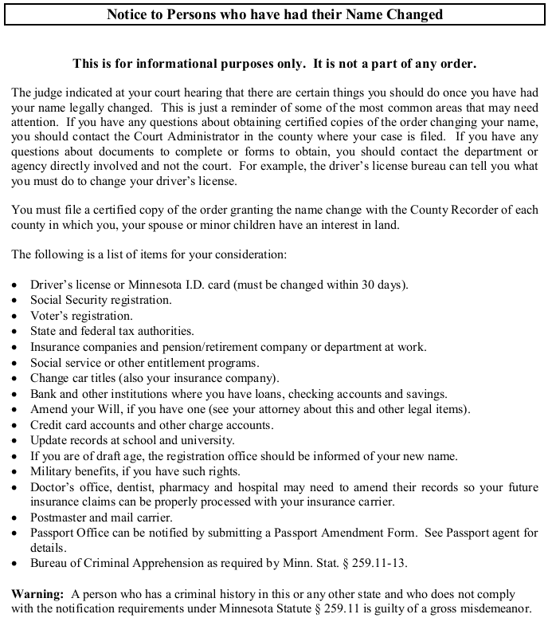

Slide 45
Identity Document Overview
Must update:
Social Security Card (ASAP)
Minnesota Driver’s License or ID (within 30 days)
May update:
Birth certificate*
Passport*
Selective Service records
Personal documents
In today’s world, the best way to protect yourself from changing future policy is to get your documents in order now.

Slide 46
Identity Documents - Social Security Cards
Requires a certified copy of the name change court order to update name.
Gender marker:
  At this time, official orders were made to stop gender marker changes in social security, but folks have intermittantly reported being able to still make them. It’s unclear how accurate those reports are.
  Gender marker was self-attestation for the past few years. Social security did not require an ACT (appropriate clinical treatment) letter from a physician to update sex marker from 2022-January 2025. Form SS-5 is used for such corrections and bring it in.
  Binary gender markers only—never got X despite the admin agreeing to provide when systems could be updated.
Registering with selective service – still based on sex assigned at birth. Matters for FAFSA and sometimes particular jobs. You can get a letter about this if you are FTM and need to explain to any entity why you did not have to register without outing yourself.

Slide 47
Identity Documents - Selective Service
Individuals have to register with selective service based on sex assigned at birth. For AMAB individuals, registration is required to access federal benefits such as FAFSA for student loans.
See: https://www.sss.gov/wp-content/uploads/2024/01/WhoMustRegisterChart_1-16-24-1.pdf
AMAB individuals who have already been registered with the Selective Service System may change their name on their records
Fill out the SS-2 Form, and attach a certified copy of the court order granting the applicant’s name change.
  https://www.sss.gov/wp-content/uploads/2021/10/Form-2-Change-of-Information-Fillable-.pdf
Updates may take up to 30 days

Slide 48
Identity Documents - State IDs
Updating name on state driver’s licenses / IDs requires a certified copy of the court order granting the name change.
Sex markers on Minnesota IDs are self selected - no documentation required. Applicants can select either a “M”, “F” or “X” marker.
*we have no reason to think X will go away in MN overall. However, Red states are passing policies that they will only issue drivers licenses in M or F, and that the info on a drivers license must match birth record. As such, there is some risk if you move to a red state that you could be denied access to documents. There is also a risk that federal policy could follow this route for Real ID, but the current statute / regulations would have to change. Folks concerned can/should early renew and get their docs now.

Slide 49
Identity Documents - Passports
Updating name on passports requires a certified copy of the court order granting the name change.
Gender markers on passports are no longer being treated as self-selected. “X” markers are not currently being issued on new / renwed passports. New passports will be based on birth record.
The intel that we are aware of indicates that results are mixed for renewals when folks have a name change but have PREVIOUSLY fixed gender marker. Most legal experts recommend waiting for more clarity, and working with national legal services if you cannot wait.
Unclear if and/or when these things will change—litigation has been filed and a court order could shift policy at any moment. Waiting to apply could set you up to file your correction after an injunction. Consider if you:
  Have something you can live with on your birth record and other documents.
  It is evergreen advice to make sure they are right and match your current self.
Not having documents that match your appearance/presentation can be a risk for harassment and/or government agents thinking you are giving false ID.
We are not aware of confirmed international travel issues related to having an X, but there are situations where border agents in countries where it is illegal to be LGBT could create an issue if they wanted to, so your choice of marker may be impacted by where you expect to travel. This is an extremely unlikely issue for someone who is otherwise being respectful in another country. Global Entry is an option to minimize human agent interaction.

Slide 50
Identity Documents - Birth Records
There are three means for correcting name and sex markers on Minnesota birth records:
Obtain a court order to correct information as part of the name change petition process, and submit it along with a birth record amendment request.
Submit an ACT (appropriate clinical treatment) letter from the applicant’s physician along with a birth record amendment request.
Petition the Minnesota Department of Health for a variance under Rule 14.055, to request an “X” gender marker or remove the gender marker entirely
https://www.health.state.mn.us/people/vitalrecords/amend.html

Slide 51
Minnesota Birth Record Variance Procedure
In cases where an individual wants to have an “X” gender marker on their birth certificate, or remove the gender marker entirely, they may petition the Minnesota Department of Health for a variance under Minn. Stat. § 14.055.

Slide 52
Minnesota Birth Record Variance Procedure
Minn. Stat. § 14.056, Subd. 1 lists the required contents for a variance petition. Things to note:
For nonbinary gender markers, seek a variance from MN Rule 4601.2525 Subd. 1 (requiring birth records to include a sex marker), and MN Rule 4601.100 Subd. 3(A)(1) (requiring two supporting documents to amend a birth record)
The petition must include reasons that justify a variance, including a signed statement attesting to the accuracy of the facts asserted in the petition. Minn. Stat. § 14.055, Subd. 4 lists factors that agencies should consider when evaluating a variance requests:
Whether application of the rule to the petitioner would result in hardship or injustice
Whether variance from the rule would be consistent with the public interest, and
Whether variance from the rule would not prejudice the substantial legal or economic rights of any person or entity.

Slide 53
Identity Documents - Personal Documents
Other documents to consider updating include:
Marriage records
Immigration documents
Bank and financial institution records
Voter registration
Entitlement program records
Leases and housing subsidy records
School records
  FERPA gives current and former students the right to amend records to match their legal documents if they are “inaccurate, misleading, or in violation of the student’s rights of privacy.”
  Denial of record amendments may raise Title IX claims - Grimm v. Gloucester County School Bd., 972 F.3d 586, 616 (4th Cir. 2020).
Insurance information
  Note that applicants should update their information with their insurance provider and physician simultaneously to avoid any coverage issues.

Slide 54
Out-of-State Documents
The process for name and gender marker changes differ substantially across states. Some LGBTQIA+ advocacy organizations maintain online information explaining the process and statutes for each state. These can be a useful first step for identifying applicable law.
  Advocates for Transgender Equality: transequality.org/documents
  Lambda Legal: https://www.lambdalegal.org/know-your-rights/article/trans-changing-birth-certificate-sex-designations
Before someone with an out-of-state birth record pursues a name change in Minnesota, it is important to:
  Decide whether to update the birth record; considerations include usefulness and meaningfulness to the client, as well as if future Federal policy required Federal documents to match birth records..
  Review the processes in the state that maintains the birth record. Some states make it very challenging to update. Decide which state to proceed in first.
  If necessary, draft a court order which incorporates the necessary language to update the birth record (only needed if court order is required).
    Call the native state’s vital records agency to determine what language they require

Slide 55
Helpful reminders
There are a lot of documents to update, so pace yourself! Focus on one step at a time. Determine which documents are most important to update sooner.
It is overall useful to have an idea of which documents can and which must be changed.
Capacity needs vary: right-size the bite and think ahead a few weeks so you have time to address what you need to.

Slide 56
Common Complications

Slide 57
Name Change Confidentiality
Name change proceedings are judicial proceedings and therefore public
May request confidential treatment under General Rule of Practice 11.04
  Rule 11.04 requires filing a motion for confidential treatment no later than the time at which the name change application is submitted
    Motion
    Affidavit
    Proposed order
    Form 11.2 Cover Sheet
Standard is a balancing test under which “interests supporting access, including the presumption in favor of access, are balanced against the interests asserted for denying access.” Minneapolis Star & Tribune v. Schumacher, 392 N.W.2d 197, 202-03 (Minn. 1986).
  Privacy is typically the interest asserted by the applicant.
Retroactive confidentiality: can be done, but usually only at the conclusion of the case

Slide 58
Name Changes with a Criminal History
Misdemeanors only: report name/gender marker change to BCA within 10 days of the Court’s order. Minn. Stat. § 259.11(b).
Felony convictions: Before filing name change application, must submit name change application to prosecuting authority that obtained the conviction. Minn. Stat. § 259.13.
  Include proof of service when filing name change application.
  Prosecuting authority has 30 days to object.
    If there is an objection, applicant must move the Court to grant the name change and show “by clear and convincing evidence that the request is not based upon an intent to defraud or mislead, is made in good faith, will not cause injury to a person, and will not compromise public safety.”
  Constitutional dimension 🡪 Minn. Stat. § 259.13, subd. 4.
    In re Application of Hanlon, A24-1615, 2025 WL 1367731 (Minn. App. May 12, 2025)
  If successful, must still report name/gender marker change to BCA within 10 days of the Court’s order.

Slide 59
Name Changes for Minors
Generally follows the adult process, with the following exceptions:
  Applicant must be legal parent, legal guardian, or next of kin of the minor.
  All legal parents must be notified of a minor’s name change application and hearing date. Minn. Stat. § 259.10.
    If both parents sign the name change application, no need for this step.
    Typically either certified mail or personal service. Check with district court clerk.
  Both the parent/guardian who applied and two other adult witnesses must attend the hearing.
  Court will consider best interests of the child
Notes:
Some Judges just want proof of knowledge, some require more in depth notice. Easiest way is to have both parents sign.

Slide 60
Out-of-state birth records
Minnesota court order not binding on another state court or agency.
Check transequality.org/documents and native state’s Department of Health website
Encourage client (or yourself) to call state’s Department of Health to inquire about the language required for the Minnesota court order
  Some states will accept the template proposed order as is (e.g., Wisconsin). Others may have more directive language or specific findings required.

Slide 61
[Ro Section- Immigration issues, community concerns, risk management, policy/federal updates?]

Slide 62
Immigration and ID Docs

Slide 63
U.S. Immigration and ID Docs for Trans, Nonbinary, and Intersex Individuals
Will the Department of State invalidate current passports that have already been updated with correct gender markers?
Will individuals be challenged when travelling domestically or internationally with their ID document?
  For domestic travel: individuals can use state identification (state driver’s licenses and ID cards are not affected by the EO)
  For international travel: Existing passports with an M, F, or X that reflect your gender will remain valid until they are up for renewal or replacement.
    Scenario: individual TSA agent is misinformed or feels empowered to pursue undue scrutiny on passport gender markers
    Scenario: you have gotten a passport under the new policy that does not match your gender and are concerned with the disparity between your presentation and the gender marker on your ID
Applying for a passport with correct gender if one has never had a passport before
Can individuals renew a U.S. passport that has their correct gender marker in it?
Can individuals update their U.S. passport with their correct gender? For now, if your current federal ID documents reflect the wrong gender marker, it is unlikely that you will be able to update them.

Slide 64
U.S. Immigration and ID Docs for Trans, Nonbinary, and Intersex Individuals
Current policy for gender markers on existing United States Citizenship and Immigration Services (USCIS) IDs with correct gender markers, including X gender markers? Much like with U.S. passports, we anticipate that IDs with correct gender markers that were issued by USCIS, including X gender markers, should remain valid until they expire. However, unlike the State Department, USCIS has not provided a clear answer to this question.
Renewing USCIS ID that has correct gender marker on it currently
Which USCIS forms allowed for X designations prior to this executive order?
How the Executive Order affects legal name changes on Passports animmigration documents
What if someone has an urgent need to travel internationally but their passport is not correct or it is held up with the Department of State?
Important information should individuals know if they are stuck with an identity document, such as a passport or work permit, issued in an incorrect gender marker

Slide 65
Policy/ Federal Updates
USCIS Registration Requirement (National Registry)
  Effective as of April 11th, 2025
  Who is considered "already registered"? What does this mean for individuals?
  Failure to register
Current policy for gender markers on new USCIS IDs
  Effective as of April 2, 2025
  USCIS now only recognizes male or female gender markers, generally determined by what is listed on an applicant’s birth certificate. This policy guidance removes the X gender marker option across all USCIS documents, and replaces the term “gender” with “sex.”
Jan 20 Executive Order
  Directed federal agencies to discriminate against transgender, nonbinary, and intersex people
  Cannot, by itself, remove rights guaranteed by the U.S. Constitution or change certain longstanding legal protections, BUT did have immediate impact on how federal agencies prioritize or enforce the law

Slide 66
Community Concerns
Name change hearings: take into account that clients might feel fearful of in-person hearings out of a concern for ICE presence, detention, or deportation. Request virtual hearings when possible, if not automatically issued.
Name changes are creating major delays and even full halts on visa applications and renewals down the line, adjustment of status applications, and asylum petitions
Rolling back protections in Asylum cases specifically
  Historically applicants must demonstrate credible fear of persecution in their home county based upon membership in a “cognizable social group,” with LGBTQ+ being a qualifying group
  Jan 20 EO removes this protection for trans and nonbinary folks; we have currently seen documented cases of asylum seekers being returned to Mexico by border agents; concern it will continue to expand to no longer include LGBTQ folks as a protected class for asylum

Slide 67
Know Your Rights: Document Specific
Do not carry foreign ID documents (e.g., passport or consular ID card) with you.
If you do not have a State ID or a Driver’s license, see if you can get a City/Municipal ID as proof of your identity.
If you have filed an immigration application, carry proof with you that the application is pending, e.g., a copy of the application receipt notice or a court-stamped copy of the application. Do not carry the original receipt or application with you, only carry copies. You could have a photo of these items on your phone.
If you have been in the United States for two or more years, carry proof of that with you. This proof could be copies of bank statements, tax returns, a lease agreement, etc. Do not carry the original receipt or application with you, only carry copies. You could have a photo of these items on your phone.
If you have a work permit (also called an Employment Authorization Document or EAD), be sure to carry it with you as proof of your status in the US. Please take immeasurable care to ensure that you do not lose your work permit.
Be sure to timely send in any applications for renewing your work permit. I recommend filing an application to renew the work permit six months before the work permit expires.
If you have an attorney, carry a signed G28 with you. If you are detained by immigration authorities, you can present the G28 and ask to contact your attorney.

Slide 68
Next Steps:
Q&A here today
Sign up to volunteer
Spread the word
Thank you!

