Slide 1

Conciliation court basics
Created and presented by
Sebastian Ellefson, Civil Program Manager
Volunteer Lawyers Network

Slide 2
Training Outline
LAP Clinic Overview
What Makes a Great Clinic Attorney?
Conciliation Court vs. District Court
Should a Client Sue?
Can a Client Sue?
Resources for Attorneys
Commonly Seen Issues
Ex. 1, Security Deposit Claim
Ex. 2, Wage Claim
Ex. 3, Consumer Debt Collection Claim
Ex. 4, Car Title Issues
Questions/Next Steps

Slide 3
Two Types of Advice Clinics
Walk-in Clinic
Hennepin County Government Center, self-help desk
No income restrictions
Attorneys have a few minutes to prepare
Internet and printer access
Phone Advice
Clients given 2-hour window to receive call, a week or more in advance
Income restrictions apply
Attorneys have a day or more to review client file

Slide 4
What Makes a Great
Clinics Attorney?

Slide 5


Time management
Set expectations. Make sure the client knows that you have a finite amount of time for him or her. Typically, attorneys & clients only meet for 15-20 minutes if other clients are waiting to be called.
Setting this from the start makes it easier to enforce.

Slide 6
Balance
Balance empathy and letting the client tell the story with….
efficiency and getting to the legal issue, which is the only issue that you can really help with.
Notes:
are so important to the client, at some point, you may need to take control of the conversation. Reviewing the client’s issue on the Clinic Data Sheet can help focus the issue quickly
If the client is focusing on irrelevant facts, providing too much detail, or simply off track, interject with pointed questions that elicit the information you need.
6

Slide 7

USING ONLINE RESOURCES
Know and use available online resources regarding the law and referrals.
Make pro se clients aware that there are several websites that provide legal forms and information.
www.LawHelpMN.org
www.mncourts.gov
www.projusticemn.org

Slide 8


Telling VLN what services you provided
Please be sure to send VLN an e-mail with
what services you provided
how much time you spent working on the case
VLN cannot credit you for your pro bono work or report the outcome of your services to our funders unless you tell us what you did and how much time you spent working on the case.

Slide 9

Sample Advise report: BAD
"Talked to client about conciliation court process. 20 minutes."

Slide 10

Sample Advise report: Good
"Spoke with client for 20 minutes. I reviewed facts with client. Oral agreement with ex on or about 9/15/24 for $8000. I advised client on types of proof she might get (bank records, txt messages, etc). I talked through filing conciliation court case, emailed her the forms. I advised client about possible collectability problems. Ex is currently unexmployed, may be judgment proof."

Slide 11


Conciliation Court vs. District Court

Slide 12
Conciliation Court vs. District Court:
Conciliation Court…
District Court…
is a court of limited jurisdiction (limited to claims of $20,000)
requires a $70 filing fee.
rules span two dozen pages in the Minnesota Rules of Court.
the vast majority of parties are self represented.
offers a forum where a pro se party can often prevail without investing a significant amount of time or money in the case.
is a court of general jurisdiction.
requires a $297 filing fee.
rules span hundreds of pages in the Minnesota Rules of Court.
judges expect pro se clients to comply with complex courts rules and meet deadlines imposed by the Scheduling Order.
For a pro se party to prevail in litigation often requires a Herculean effort which most clients cannot afford to make, even if the filing fee is waived.

Slide 13
different service rules
Conciliation Court…
District Court…
If a plaintiff is suing for $2,500 or less, the court simply mails the defendant the Statement of Claim & Summons by first class mail.
no Affidavit of Service is required
If a plaintiff is suing for more than $2,500, the defendant must be either personally served or served via certified mail.
Affidavit of Service must be filed.
To start a lawsuit, the defendant usually must be personally served.
A defendant can be served via first class mail only if the defendant consents to be served by mail by singing an Acknowledgment of Service.
If the defendant can’t be found, the defendant can be served via “Service By Publication” though rarely is this advisable in a clinic setting.

Slide 14

Conciliation Court is the BEST place for a pro se party to sue
Conciliation Court lawsuits don’t involve much paperwork.
Defendants who are sued don’t need to serve an Answer. They just need to show up at the (usually Zoom) hearing in order to defend themselves.
The lack of a written Answer may give Plaintiffs an inherent advantage.
There is no discovery phase.

Slide 15


Analogize to TV shows!
How do I explain the differences between Conciliation Court and District Court to a client?
Vs.

Slide 16

SHOULD A CLIENT SUE?

Slide 17

Collectability is Question #1
Assessing the likelihood that the opposing side can or will pay (i.e., has income or assets that can be garnished or levied) in order to satisfy the judgment, should be the first step when deciding whether to sue.

Slide 18

Winning a judgment is not the same thing as collecting on a judgment!
Most clients do not understand that the court is not a collection agency, and the client alone is responsible for all aspects of collecting on the judgment.
Many judgment creditors become angry when they finally realize that all of their efforts to win a judgment were for naught if the judgment debtor is judgment proof, goes bankrupt, or is a business or corporation that is inoperative.

Slide 19
Suing Can Take A Very Long Time!
A Conciliation Court case filed today will not have a hearing for about 3 months.
District Court lawsuits may go on for months or more than a year before a trail. Complying with a judge’s Scheduling Order just to make it to a trial may be difficult.
For example, on 03/27/2008, VLN helped a client file a Conciliation Court lawsuit for return of her $300 security deposit
After winning a judgment on 08/05/2008, the landlord appealed to District Court.
Two years, much litigation and a court trial later, the District Court finally entered judgment in favor of the client on 08/06/2010.

Slide 20
Can a client sue in Conciliation Court?
Subject Matter Jurisdiction
& Personal Jurisdiction
See Minn. Stat. § 491A.01

Slide 21
Conciliation Court Subject Matter Jurisdiction: Conciliation Court is a court of limited jurisdiction and cannot hear every type of claim. See Minn. Stat. § 491A.01
Acceptable Claims:
Defective goods sold or service provided
Damage to property or vehicle
Back rent owed
Accident repair expenses not paid
Bounced check
Damage deposit not returned
Wages not paid
Return of property (Replevin)
Unacceptable Claims:
Title to real estate
Libel or slander
Specific performance or injunction
Class Actions
Medical malpractice
Discrimination claims
Actions against deceased persons

Slide 22
GENERALLY, A CLAIM MUST BE FILED IN THE COUNTY WHERE THE DEFENDANT RESIDES.
Exceptions include:
A claim for a bad check must be filed in the county where the check was tendered.
A claim against multiple defendants can be filed in the county in which one or more of the defendants resides.
Claims for security deposits or rent may be filed in the county in which the rental property is located.

Slide 23
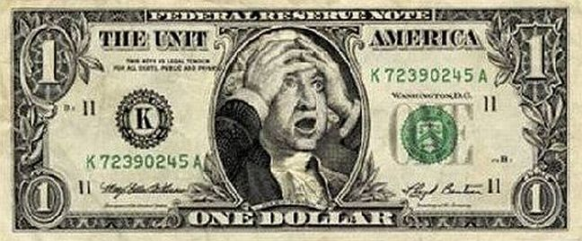
The $20,000 Question
Conciliation Court can hear claims up to $20,000. It can also order that personal property be returned.
If a party’s claim exceeds the maximum of $20,000, the party must state on the claim that he or she is asking for the lower amount for the court to have jurisdiction.
A party can also include the $70 cost of the filing fee in the claim, so technically the largest judgment that someone can win in Conciliation Court is $20,070.

Slide 24
What’s the #1 Mistake in Conciliation Court Claims?
Botching the Defendant’s name!

Slide 25
Must have the correct address of the defendant.
Without an address, there is almost always no point in continuing the suit. Most clients don’t have what it takes to effect service by publication.
Has the correct name of an individual defendant. Don’t sue “Jim Smith” when you can sue “James Robert Smith.”

Slide 26

Improperly naming a corporate Defendant can lead to an uncollectible judgment!
If the Plaintiff sued and won a judgment against “ACME” and the corporation’s actual name was “ACME Associates III, LLC” any effort to serve a garnishment summons upon “ACME” will not impound the accounts owned by “ACME Associates III, LLC” and all of the company’s real property and other assets will be held in the company’s actual legal name.
Always check for the full legal name of a company by searching the Minnesota Secretary of State’s website at: http://mblsportal.sos.state.mn.us/

Slide 27
Resources for Attorneys

Slide 28

Substantive Law resources
Housing Law Issues
Car Title Transfer
Wage Claim
Debt Collection / Wage Garnishment
VLN Staff Attorney available at Court Clinic or by phone

Slide 29
Commonly Seen Legal Issues

Slide 30

Example case 1: security deposit

Slide 31
Tammy the Former Tenant
Tammy moved out of her apartment after her lease expired. The landlord sent her a letter stating that all of Tammy’s $600 security deposit (plus $6 in interest) will be kept by the landlord to pay for damage to her apartment, and says she still owes more money for the damage.
Tammy denies causing damage and wants to sue in Conciliation Court the property manager for return of her deposit, for defamation of character, and for pain and suffering.
What advice to give to this client?

Slide 32
Advice outside of substantive law
(what you should say without knowing anything about housing law)
Sue proper party (building owner, not property manager)
Conciliation Court cannot hear claims for slander or libel
Pain and suffering claims will not prevail
The Conciliation Court does have jurisdiction to decide the security deposit claim, and it appears to be well within the $ limit
Suing the landlord may open Tammy up to a counterclaim
Getting $ through court takes time

Slide 33
No Extra-Contractual Damages in Contract Cases!
In the absence of specific statutory provisions, extra-contractual damages, such as emotional distress, are not recoverable for breach of contract except in exceptional cases where the breach is accompanied by an independent tort.
Lickteig v. Alderson, Ondov, Leonard & Sween, P.A., 556 N.W.2d 557, 561 (Minn. 1996); Haagenson v. National Farmers Union Property & Cas. Co., 277 N.W.2d 648, 652 (Minn. 1979); Olson v. Rugloski, 277 N.W.2d 385, 388 (Minn. 1979); Wild v. Rarig, 302 Minn. 419, 440, 234 N.W.2d 775, 789 (1975); see William Lloyd Prosser, The Borderland of Tort and Contract, in Selected Topics On the Law of Torts 380, 426 (1953) (noting in contract actions, there is no recovery for mental suffering). The accompanying independent tort must be willful and support the extra-contractual damages in its own right. Lickteig, 556 N.W.2d at 561.
A malicious motive in breaking a contract will not convert a contract action into a tort action.
Id.; see Wild, 302 Minn. at 442, 234 N.W.2d at 790 (concluding bad faith breach of contract does not become tort).

Slide 34
Minn. Stat. § 504B.178 INTEREST ON SECURITY DEPOSITS; WITHHOLDING SECURITY DEPOSITS; DAMAGES; LIMIT ON WITHHOLDING LAST MONTH'S RENT
Subd. 3. Return of Security Deposit.
Every landlord shall within three weeks after termination of the tenancy and after receipt of the tenant's mailing address or delivery instructions, return the deposit to the tenant, with interest thereon or furnish to the tenant a written statement showing the specific reason for the withholding of the deposit or any portion thereof.
Subd. 4. Damages.
Any landlord who fails to provide a written statement within three weeks of termination of the tenancy after receipt of the tenant's mailing address or delivery instructions is liable to the tenant for damages in an amount equal to the portion of the deposit withheld by the landlord and interest thereon as a penalty, in addition to the portion of the deposit wrongfully withheld by the landlord and interest thereon.
Subd. 7. Bad Faith Retention.
The bad faith retention by a landlord of a deposit, the interest thereon, or any portion thereof, in violation of this section shall subject the landlord to punitive damages not to exceed $500 for each deposit in addition to the damages provided in subdivision 4. If the landlord has failed to comply with the provisions of subdivision 3 or 5, retention of a deposit shall be presumed to be in bad faith unless the landlord returns the deposit within two weeks after the commencement of any action for the recovery of the deposit.

Slide 35
How much is Tammy’s claim?
$600 security deposit
+ $6 interest
+ $606 in statutory damages pursuant to Minn. Stat. § 504B.178, subd. 4
+ $500 in statutory punitive damages pursuant to Minn. Stat. § 504B.178, subd. 7
+ $70 Conciliation Court filing fee
= $1,782 Claim

Slide 36

Example case 2: wage claim

Slide 37
Sammy the Server
Sammy is college student. Sammy has worked at Danny Deadbeat’s Diner since it opened six months ago. Sammy gets paid weekly, but their hours and income vary from week-to-week depending on the amount of business. Sammy also makes tips.
Danny Deadbeat’s Diner is an assumed name, and the name-holder and owner of the business is an entity called Deadbeat Eats, LLC.
Unfortunately, Sammy hasn’t gotten a paycheck in the three weeks, and Danny told the whole staff that the restaurant is closing after this weekend. Business has been terrible lately.
Danny did not say when employees will be paid so Sammy walked out on their shift and sent Danny a text message saying Sammy won’t work the weekend and needs to be paid immediately because their rent is due in a few days.

Slide 38

Will suing help Sammy make the rent due in a few days?
No, if Sammy filed a lawsuit today it would likely take 10-12 weeks just to get a hearing.
What other options to pay the rent might Sammy consider?
Applying for unemployment benefits?
Finding a new job?
Applying for emergency assistance?
Borrowing money from family & friends?
Illegal Self-Help? – Sometimes clients suggest taking illegal self-help remedies after learning about the difficulties associated with suing and collecting. Advise against this!

Slide 39
Will suing get Sammy their money back in the long-term?
Maybe, maybe not.
If Deadbeat Eats, LLC cease to operate and no longer has any income or assets, any judgment will be unenforceable.
Deadbeat Eats, LLC may also file for bankruptcy. Sammy should consult a bankruptcy attorney regarding submitting a proof of claim in any bankruptcy proceeding. VLN has a bankruptcy clinic that can help with this.

Slide 40

When should be paid former employee be paid? It depends.
www.lawhelpMN.org has information that answers most of client’s basic questions regarding wage claims.
If the client was fired or laid-off, Minnesota law requires that they are paid within 24 hours after requesting payment.
If the client quit or resigned, they must be paid on or by the next regular payday unless it is less than 5 days away. Then the employer can wait until the second payday. The client must be paid within 20 days of their last day.

Slide 41
Wage Claims
Minn. Stat. § 181.14 PAYMENT TO EMPLOYEES WHO QUIT OR RESIGN; SETTLEMENT OF DISPUTES.
Subd. 2.Nonprompt payment.
Wages or commissions not paid within the required time period shall become immediately payable upon the demand of the employee. If the employee's earned wages or commissions are not paid within 24 hours after the demand, the employer shall be liable to the employee for a penalty equal to the amount of the employee's average daily earnings at the employee's regular rate of pay or the rate required by law, whichever rate is greater, for every day, not exceeding 15 days in all, until such payment or other settlement satisfactory to the employee is made. The employer shall also be liable to the employee for the amount of wages and commissions that are earned and unpaid. An employee's demand for payment under this section must be in writing but need not state the precise amount of unpaid wages or commissions. An employee may directly seek and recover payment from an employer under this section even if the employee is not a party to a contract that requires the employer to pay the employee at the rate of pay demanded by the employee, so long as the contract or any applicable statute, regulation, rule, ordinance, government resolution or policy, or other legal authority requires payment to the employee at the particular rate of pay. The employee shall be able to directly seek payment at the highest rate of pay provided in the contract or applicable law, and any other remedies related thereto as provided in this section.

Slide 42

What are Sammy’s “Average Daily Earnings”?
From a practical standpoint, since Sammy’s hours vary significantly from day-to-day and week-to-week given the changing schedule of her serving job, they are in a much better position to figure out what she is owed than any volunteer attorney. There is often not enough time at the clinic to help clients calculate their average daily earnings.

Slide 43
Who to name as Defendant?
“Danny Deadbeat’s Diner”
“Deadbeat Eats, LLC”
This is nothing more than the name painted on the sign outside of the restaurant that Sammy works at. Should they sue “Danny Deadbeat’s Diner”?
Danny Deadbeat is such an ego-maniac that he just had to include his own name on the sign in bright flashing lights. Can Sammy sue Danny as an individual?
This is a limited liability company that is registered with the Minnesota Secretary of State. However, the registered address of the LLC is a different address than the restaurant. Is this important?
The LLC is the entity that issued Sammy pay-checks when they were actually getting paid. There’s no employee handbook.

Slide 44

Example case 3: consumer debt
Welcome to the Wild West of Debt Collection!

Slide 45
Dante the debtor
Dante received a letter in the mail from a law firm, claiming he owes $5,000 from a company he's never heard of. It says he has 21 days to respond, or a default judgment will be entered
The papers looks official, but there is no court file number, and looking at online filings, there is no case filed with the court
Is this a scam? Should it be ignored until something is actually filed?

Slide 46


What is Pocket Filing?

Slide 47
Minnesota’s Unique Court Rules & Garnishment Statutes
In Minnesota, original creditors and debt purchasers may commence district court lawsuits without filing them (see Minn. R. Civ. Pro. 3.01), garnish bank accounts and wages without paying a filing fee (see Minn. Stat. § 571.71), and obtain default judgments without producing evidence to substantiate their claims (see Minn. R. Civ. Pro. 55.01(a)).
Minnesota is one of only three states that does not require a plaintiff to file a lawsuit. This is often referred to as “pocket filing” or “pocket service.”

Slide 48
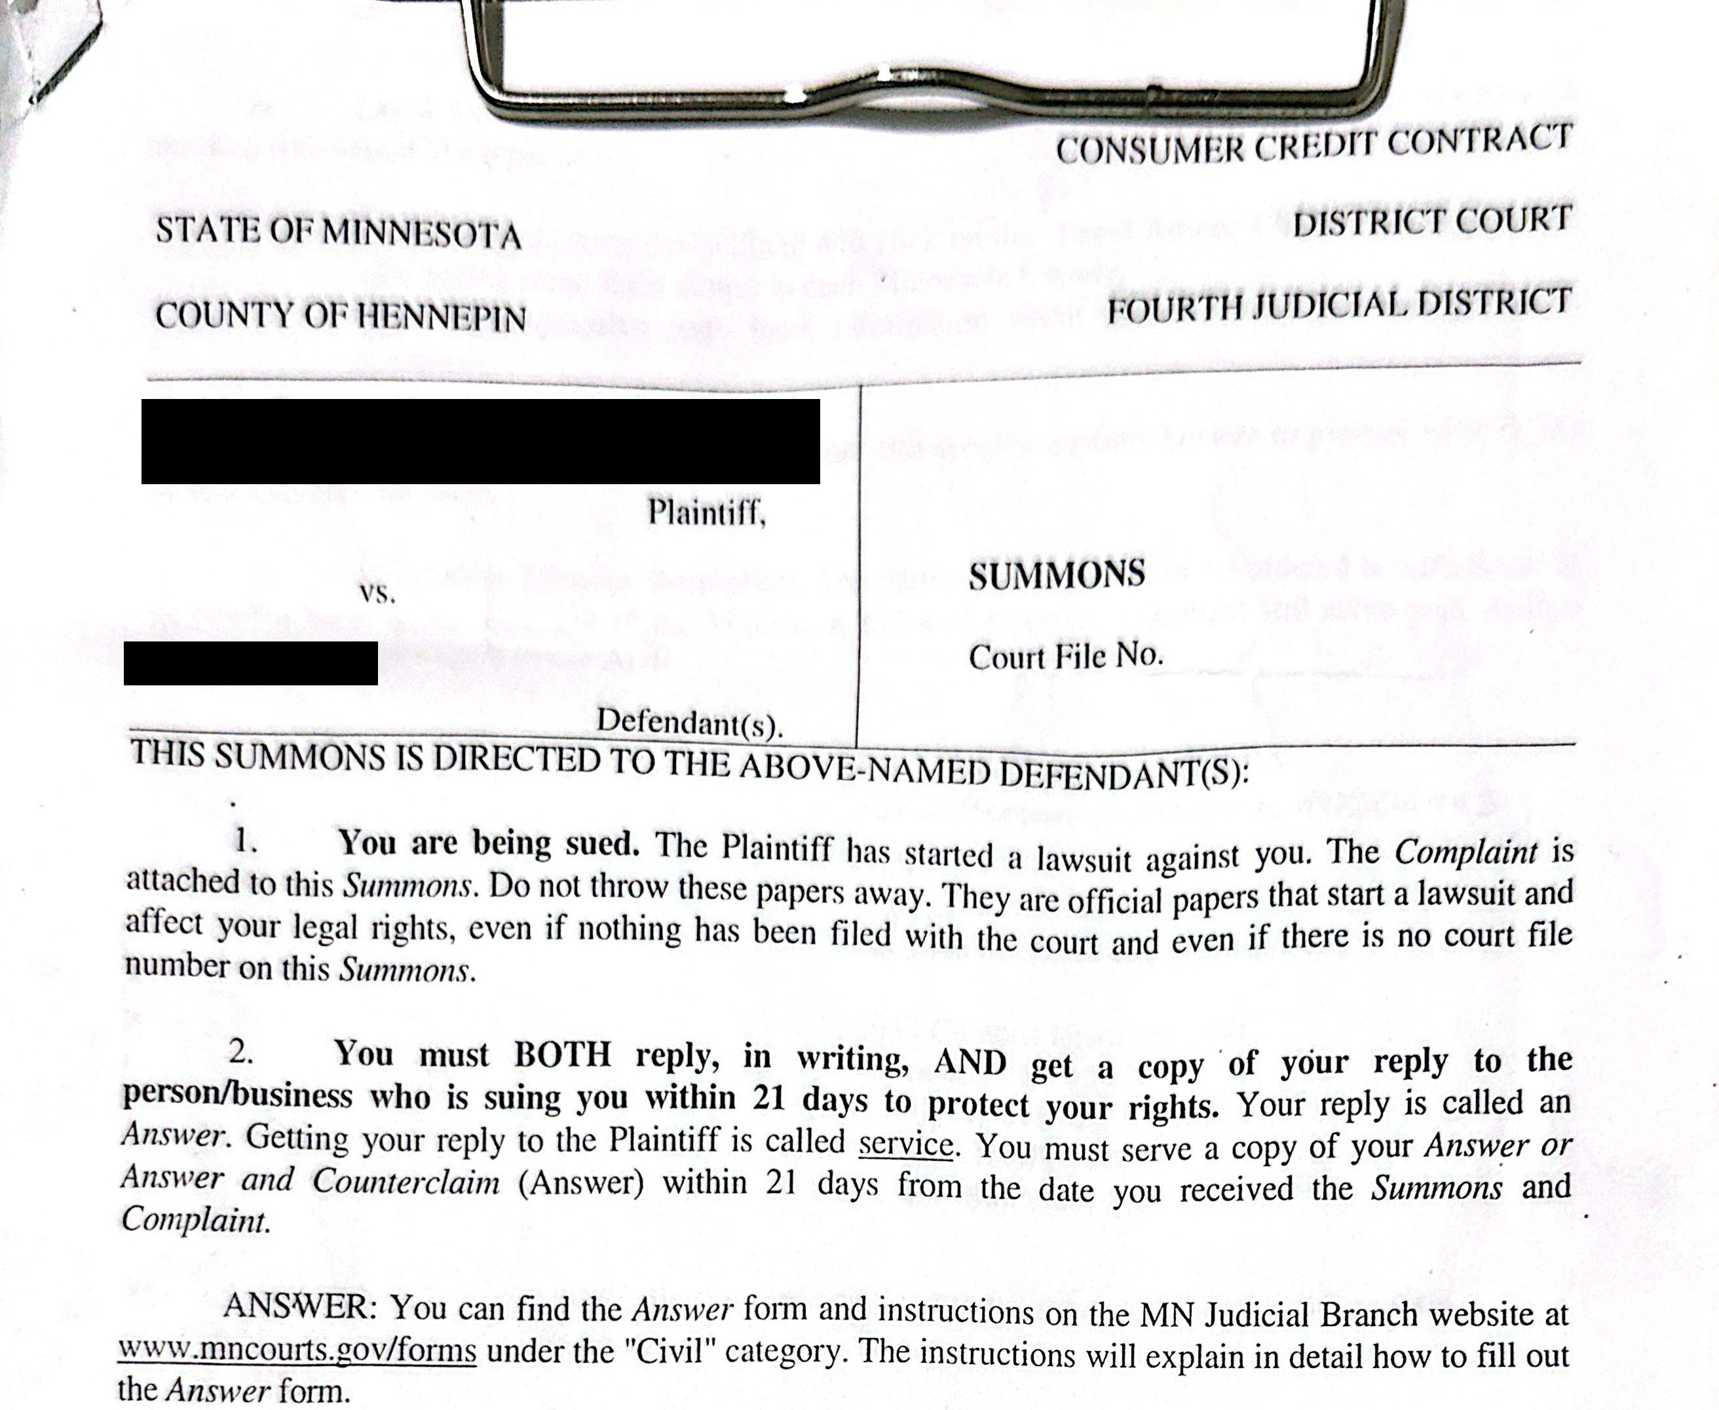

Slide 49

Minnesota’s Unique Court Rules & Garnishment Statutes
Since a plaintiff can start a lawsuit in Minnesota without paying a filing fee and win a judgment without appearing at any hearing, it’s often quicker and easier to win a default judgment in a District Court lawsuit than in a Conciliation Court lawsuit.
Most District Court default judgments are entered and docketed administratively by the Court Administrator with little to no judicial oversight.

Slide 50

To Answer, or Not To Answer

Slide 51

There’s no point in fighting a losing battle
It may be cheaper and easier for a client without any defenses to a collections lawsuit to lose by default judgment at the beginning of a lawsuit rather than months later on summary judgment.
Nearly all credit card contracts have attorneys’ fees provision requiring the debtor to pay in the event of default followed by collection litigation.

Slide 52
bAd defenses
Client admits they owe money, but the amount listed is wrong
Client has not heard of Plaintiff / debt buyer

Slide 53
The best affirmative defenses in debt buyers cases….
Lack of Standing
Invalid Assignment
Plaintiff lacks standing
Plaintiff’s claims, may be barred, in whole or in part, by an invalid assignment of the account that is the subject matter of this suit, and Defendant does not consent to or ratify any assignment of Defendant’s account.
Mistaken Identity
If you client has a common name

Slide 54

Example case 4: car title transfer
This Photo by Unknown author is licensed under CC BY-SA-NC.

Slide 55

Keisha and the car sale
Keisha sold her car to her cousin's friend, Deshawn. Deshawn paid in cash and she handed over the title to him. She dutifully submitted notice of sale to DVM
A few months later, she's received several parking tickets in the mail. She tried to reach out to Deshawn but he's blocked her number.
How did this happen? How can she get the car out of her name? Is Keisha responsible for these tickets?

Slide 56

How car title transfer works Minn. Stat. § 168A.10
At time of sale, Seller executes an "Assignment of Title" to the buyer
Within 10 days of sale, Seller must submit "Notice of Sale" certificate to DVS
Within 10 days of sale, Buyer must execute an "Application for a New Certificate of Title" and deliver to DVS
Ideally, this all occurs at the same time, at the time of sale, at a DVS facility!

Slide 57
IS keisha responsible for the payments?
No!
Minn. Stat. § 168.10 Subd. 5. Compliance removes liability after delivery
Except as provided in section 168A.11 and as between the parties, a transfer by an owner is not effective until the provisions of this section have been complied with; however, an owner who has delivered possession of the vehicle to the transferee and has complied, or within 48 hours after such delivery does comply, with the provisions of this section requiring action by the owner is not liable as owner for any damages resulting from operation of the vehicle after the delivery of the vehicle to the transferee. An owner is not liable who has complied with the provisions of this section except for completing and returning the Notice of Sale or transmitting the required information electronically under subdivision 1

Slide 58

How to force title transfer
File Notice of Motion and Motion for Order Directing Change of Title to a Motor Vehicle
Form for buyer available on court website
Forms for seller available from VLN
Commissioner of DVS is one of the defendants

Slide 59
Questions?

Slide 60
Thank you!
Please don’t hesitate to contact me!
Sebastian Ellefson
Tel: 612-752-6676
E-mail: sebastian.ellefson@vlnmn.org

